Slide 1
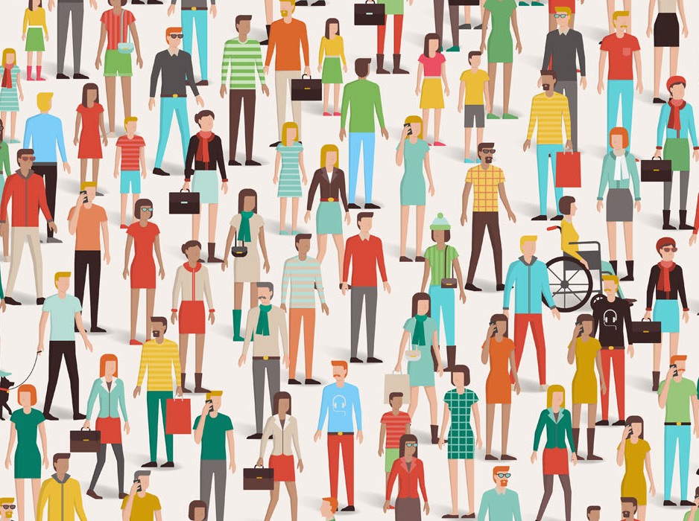
The institution-wide impact of accessibility

Slide 2

Nicolaas Matthijs
Product Manager, Blackboard Ally
@nicolaasm

Slide 3
Accessibility ≠ Disability

Slide 4
Accessibility
Accessibility refers to the design of products, devices, services, or environments for people who experience disabilities. The concept of accessible design and practice of accessible development ensures both "direct access" (i.e. unassisted) and "indirect access" meaning compatibility with a person's assistive technology.
- Wikipedia

Slide 5




Accessibility
Approximately 1 Billion people worldwide have some form of disability
Disability Types:
Visual
Impairment
(~3% of population)
Hearing
Impairment
(~5% of population)
Motor
Impairment
(~6% of population)
Cognitive
Impairment
(~25% of population)
*Sources: http://www.disabled-world.com/ & http://www.who.int/

Slide 6
This is a problem
Absolutely true and important
Too limited
Binary disabled vs not disabled classification
Act as an excuse to not care
Excludes many people that can benefit from improved accessibility

Slide 7

This is a problem

Slide 8

What If

Slide 9
Universal Design
Universal design refers to broad-spectrum ideas meant to produce buildings, products and environments that are usable to the greatest extent possible by everyone, regardless of their age, ability, or status in life.
- Wikipedia

Slide 10
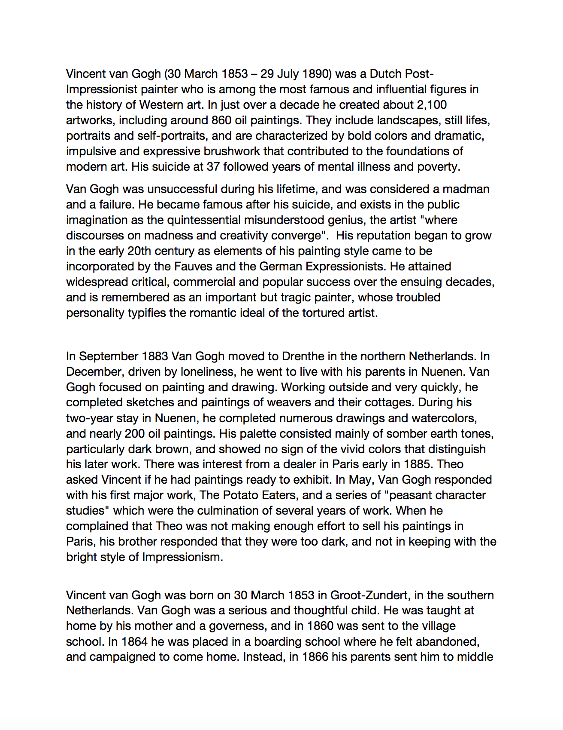
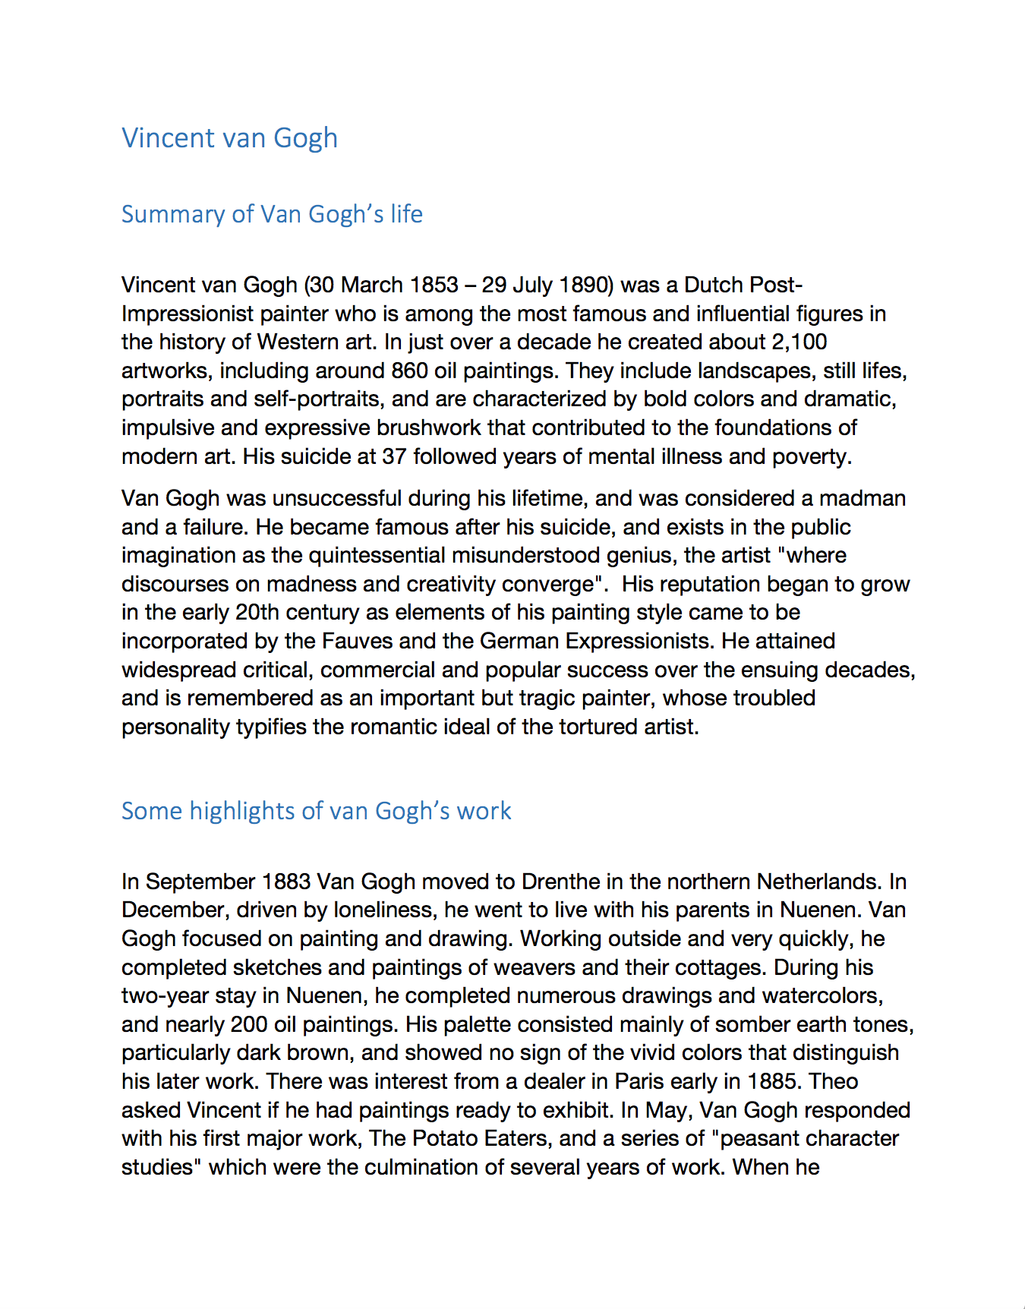
Example 1: Heading Structure

Slide 11
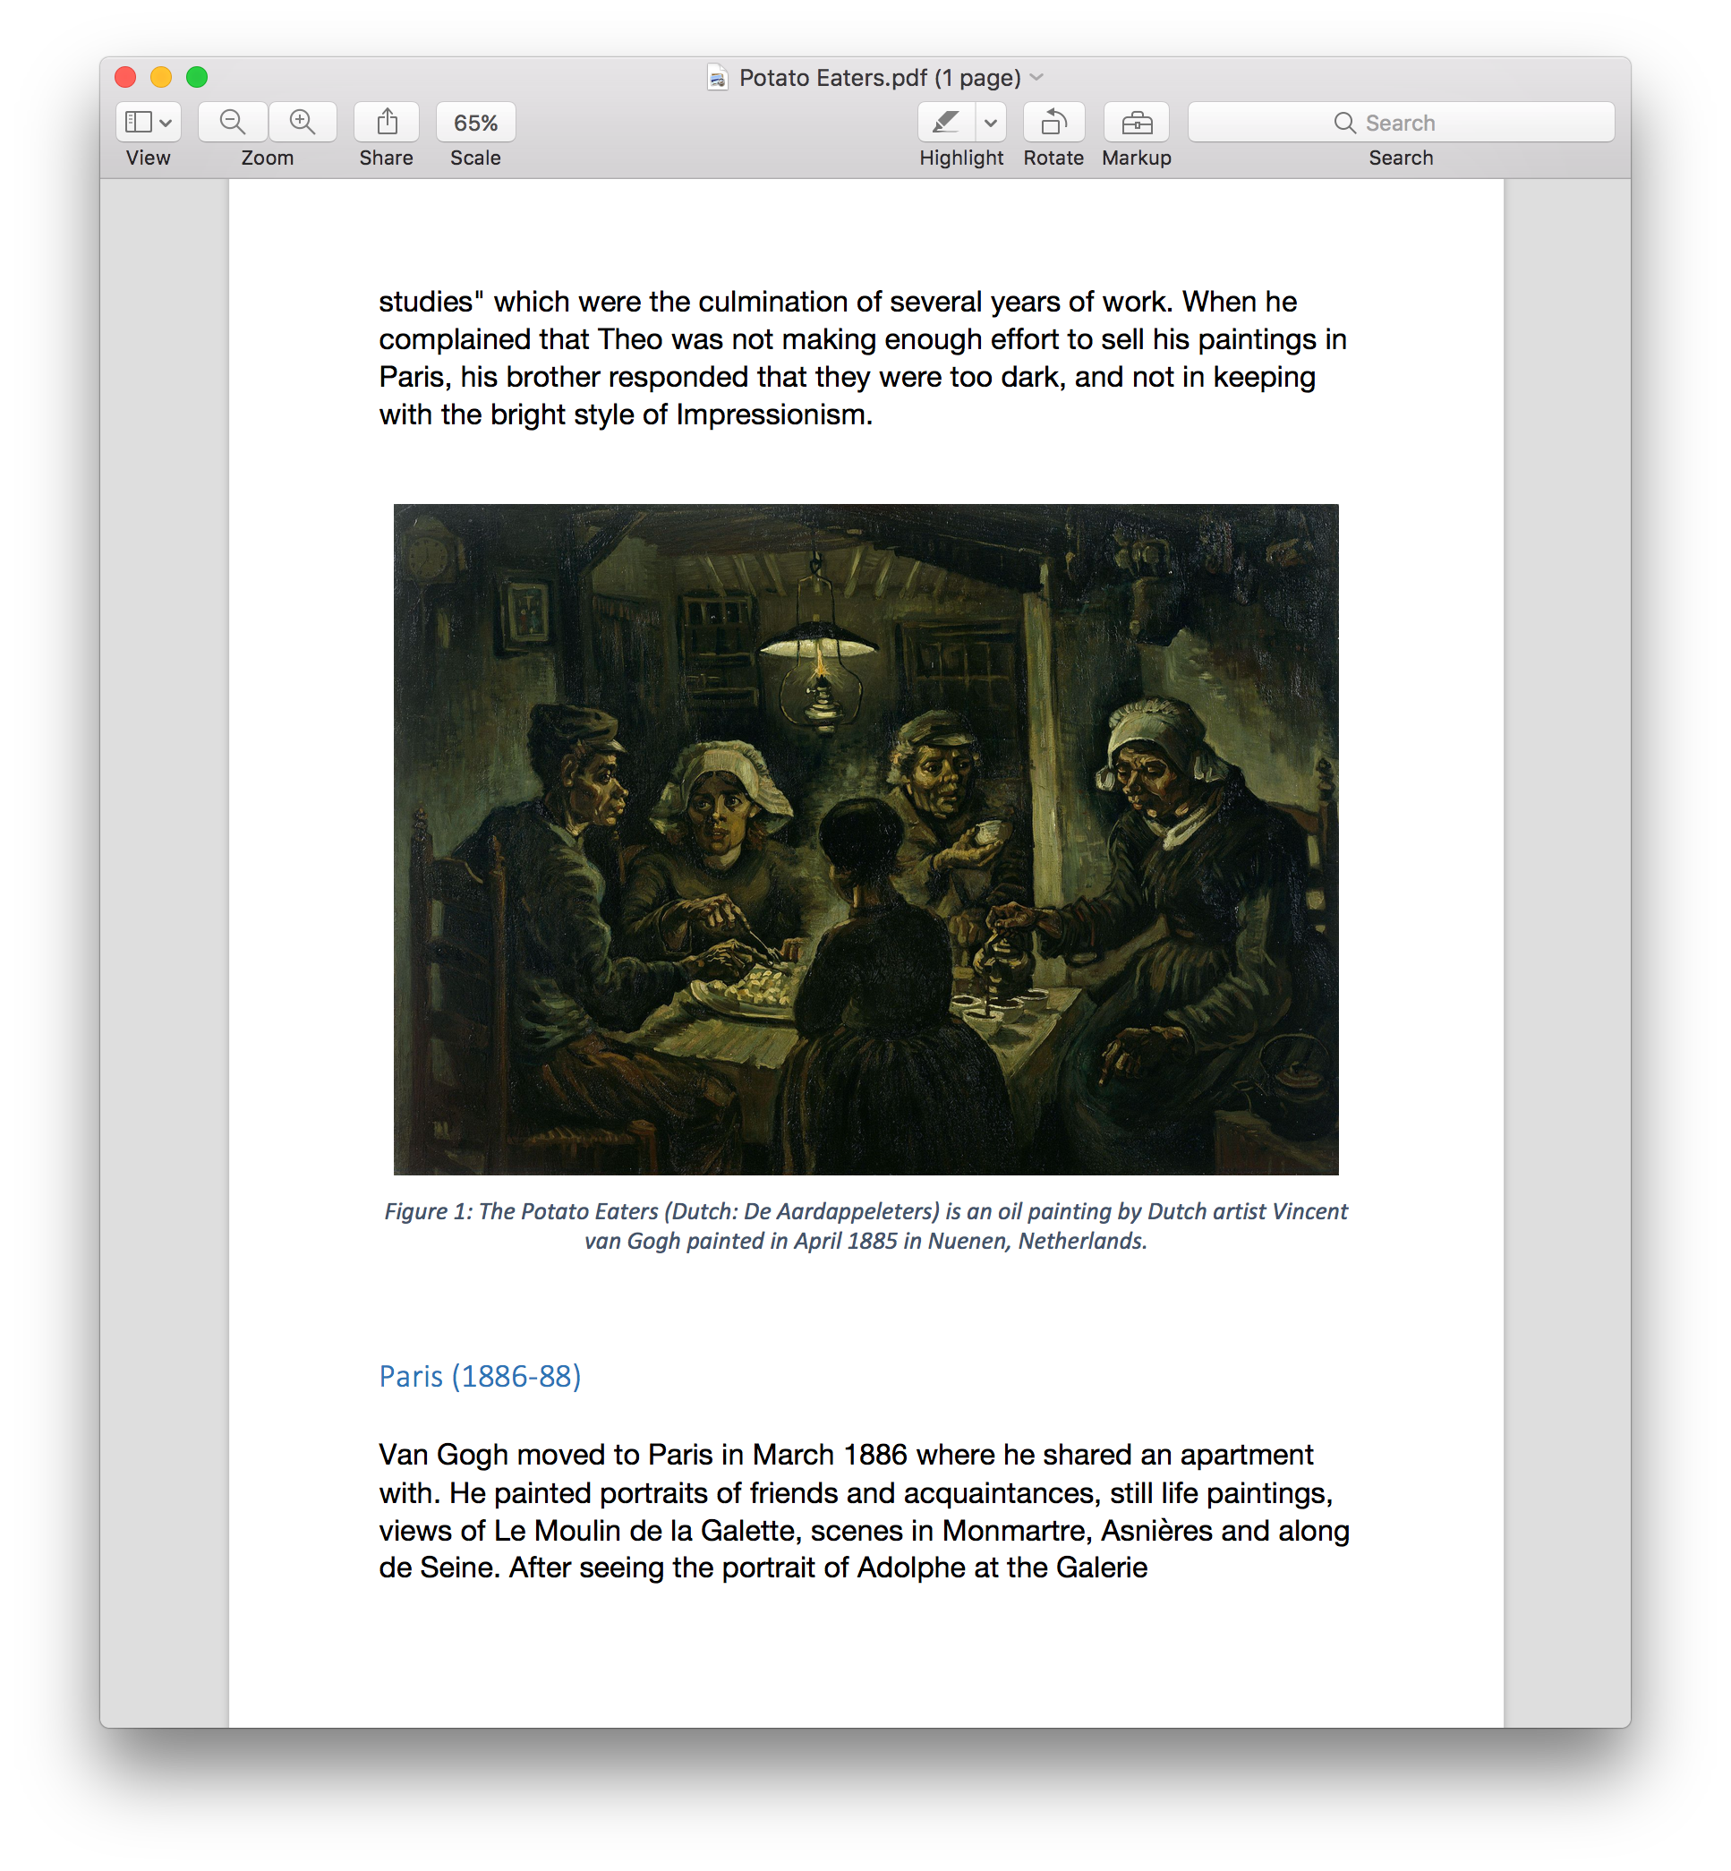
Example 2: Image Caption

Slide 12
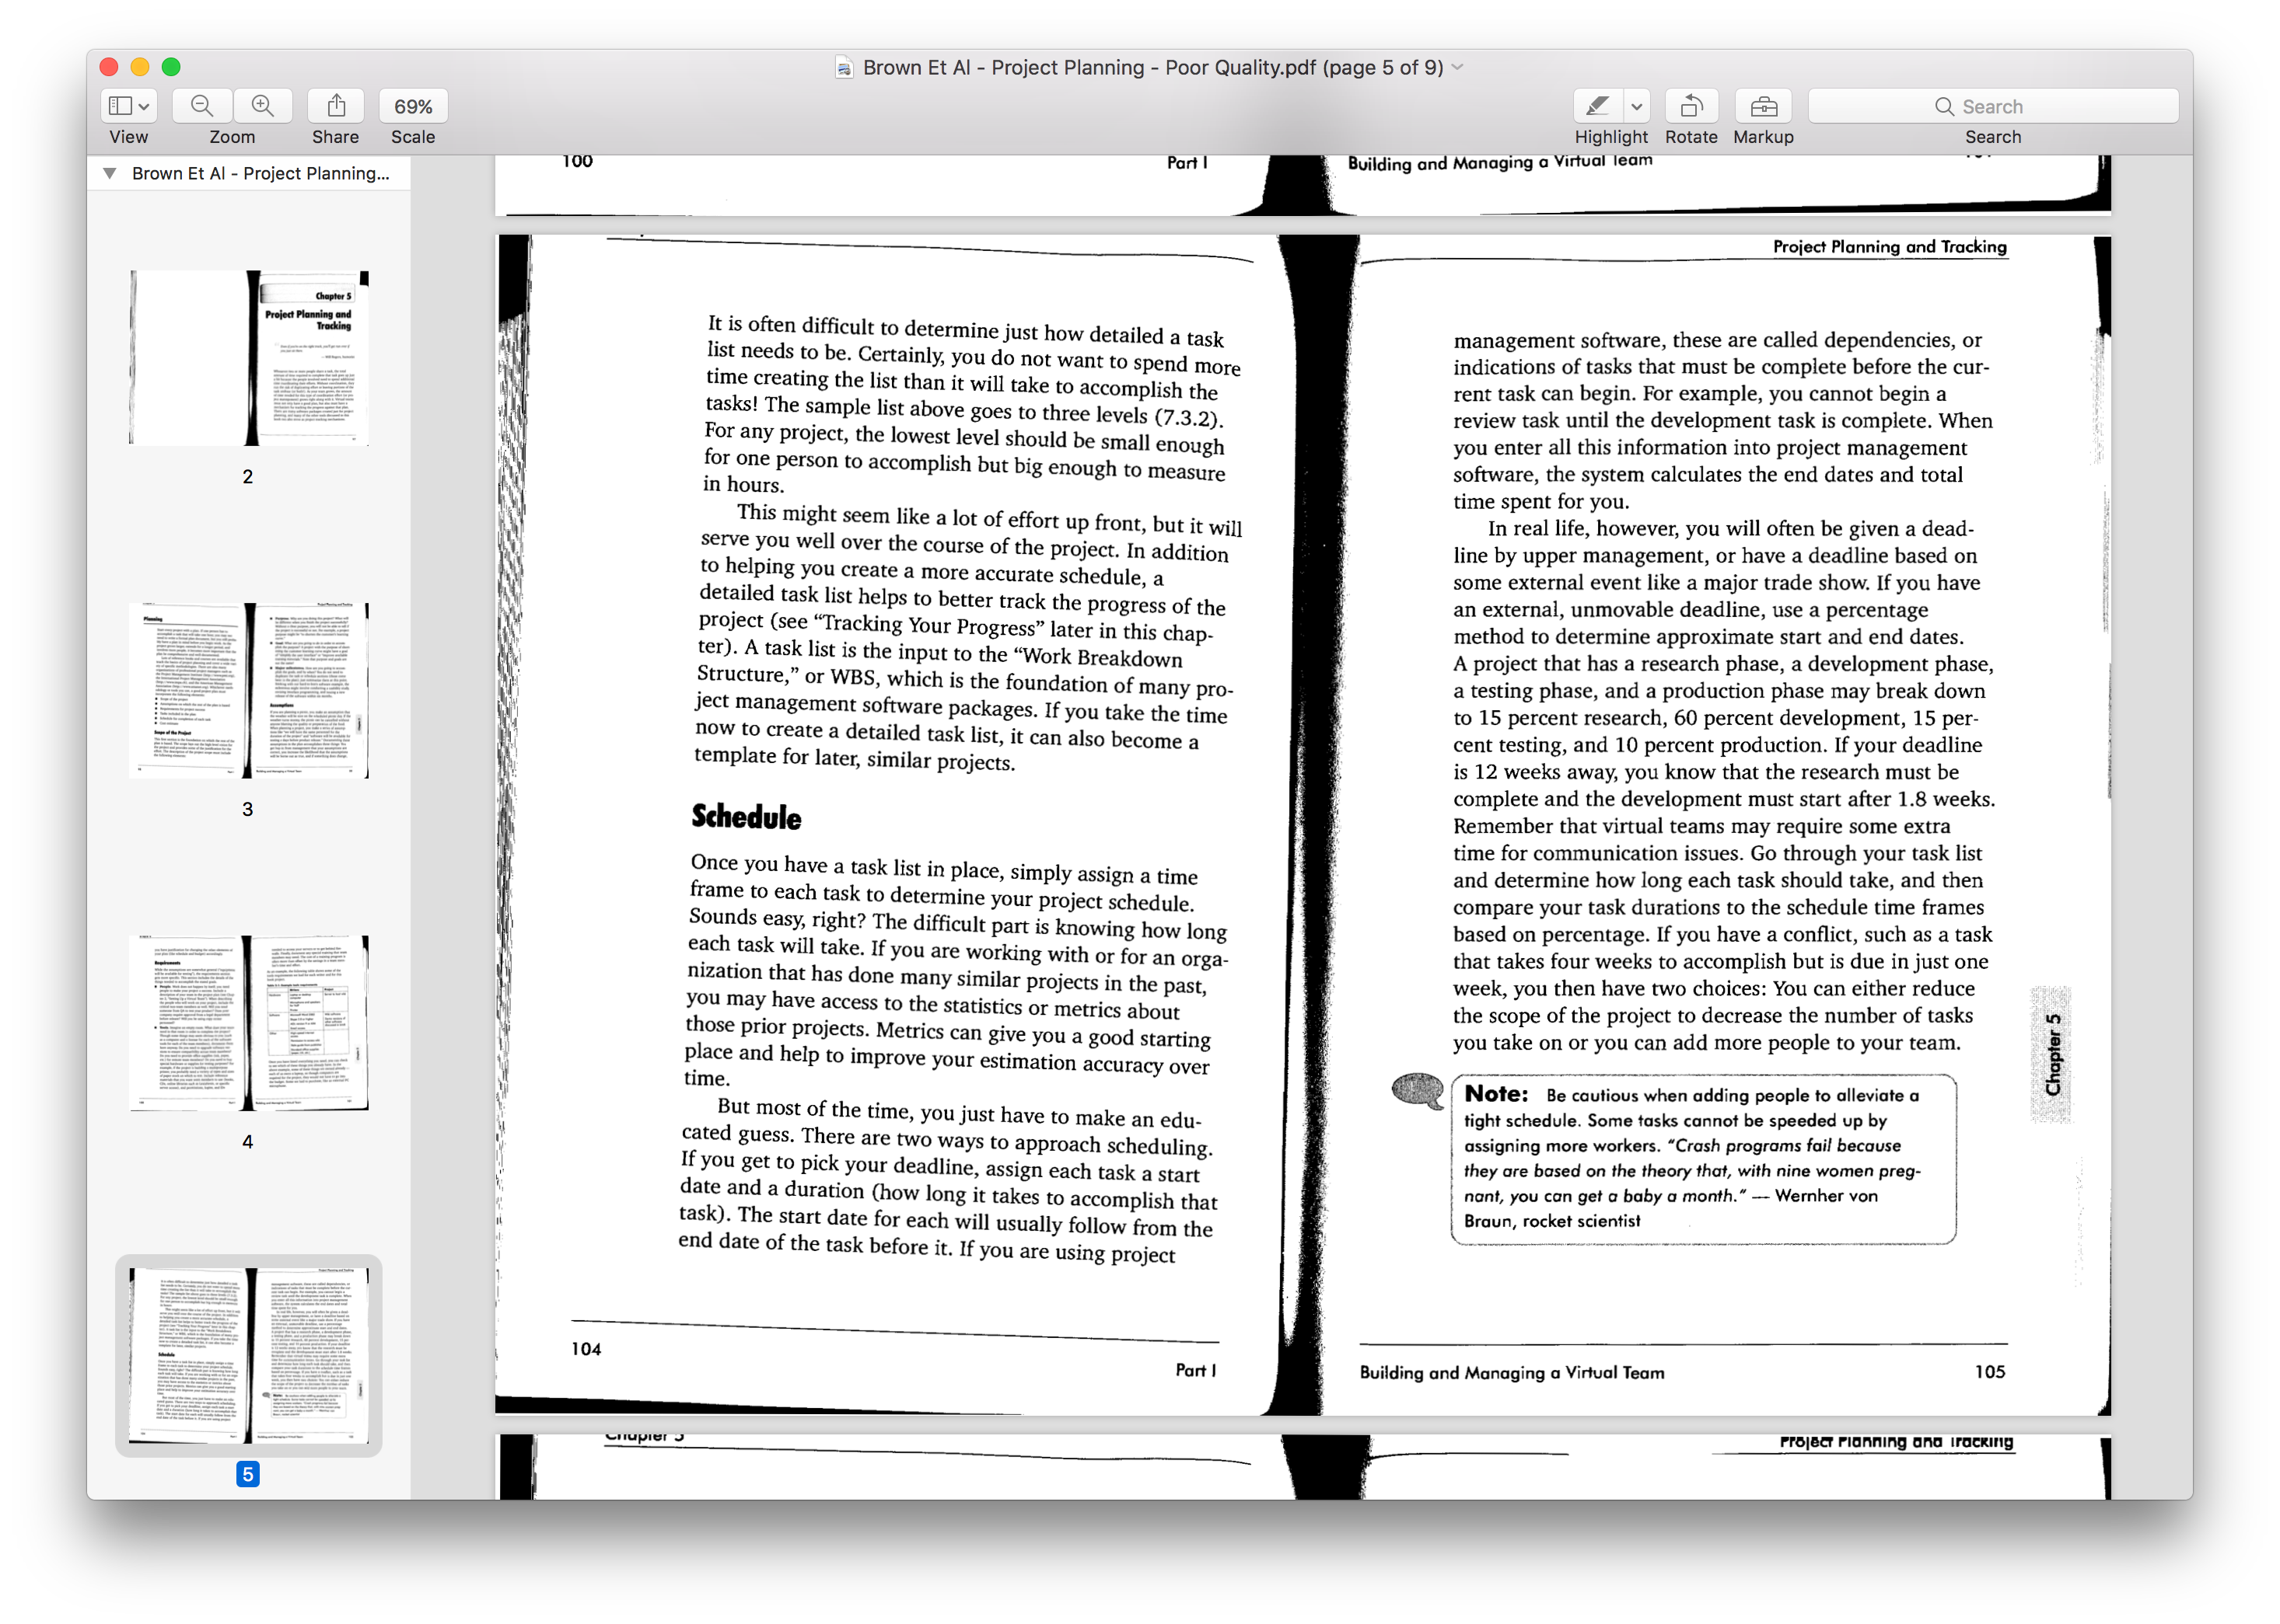
Example 3: Scanned Document

Slide 13
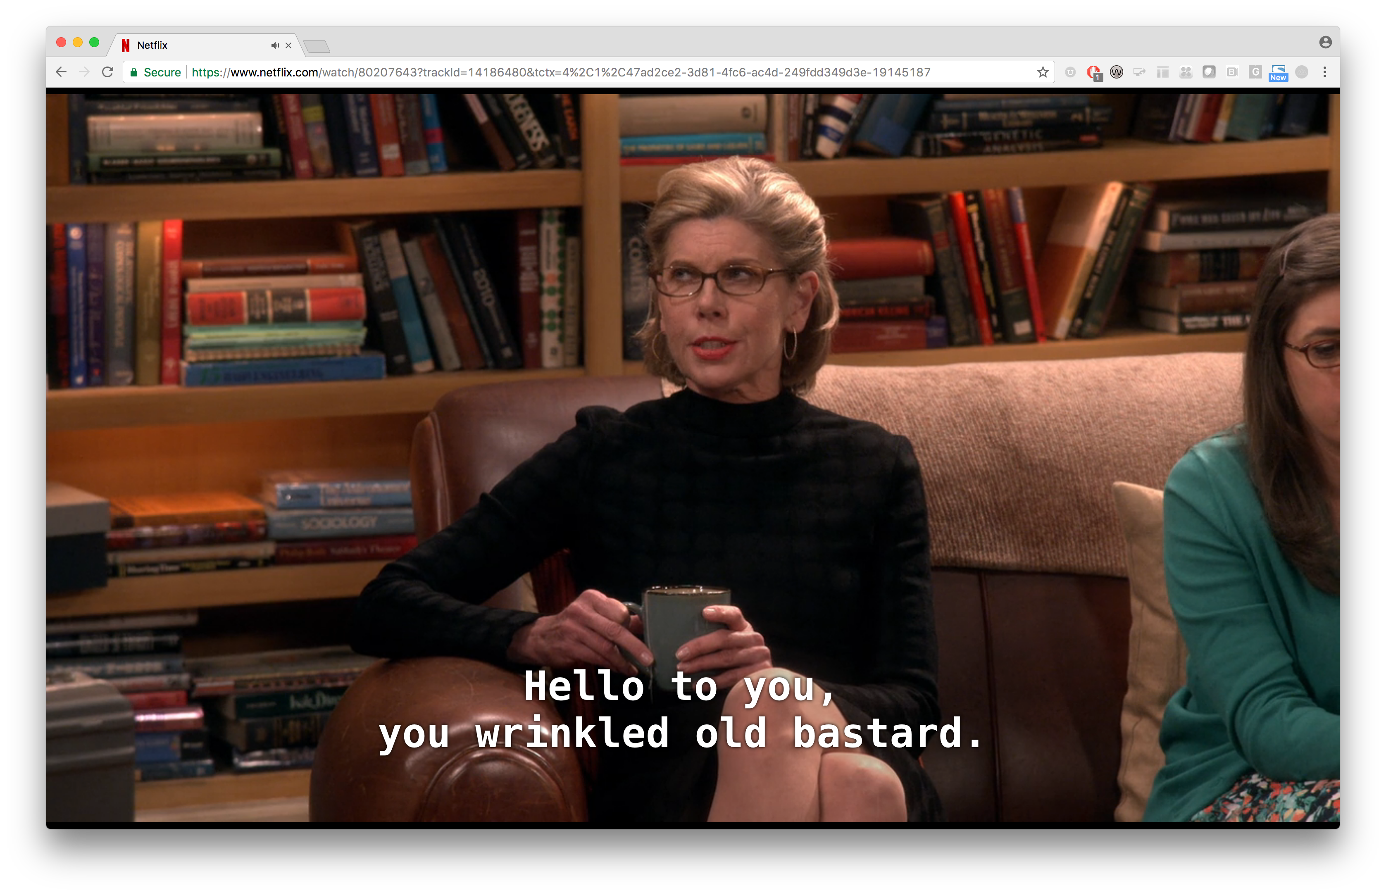
Example 4: Captions/Subtitles

Slide 14
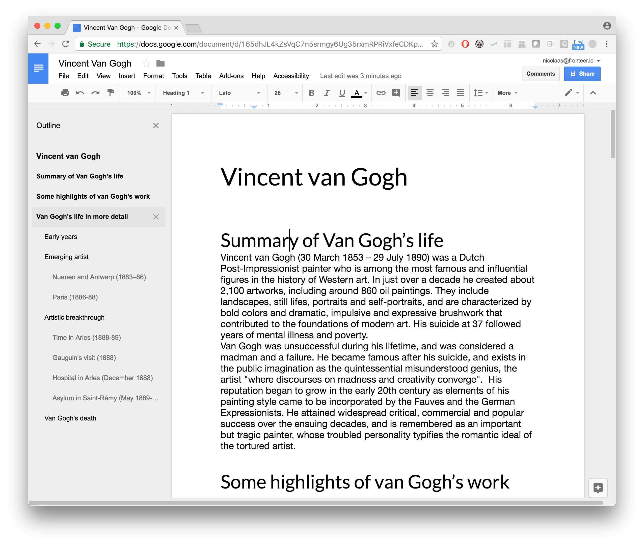
Example 5: Google Docs

Slide 15

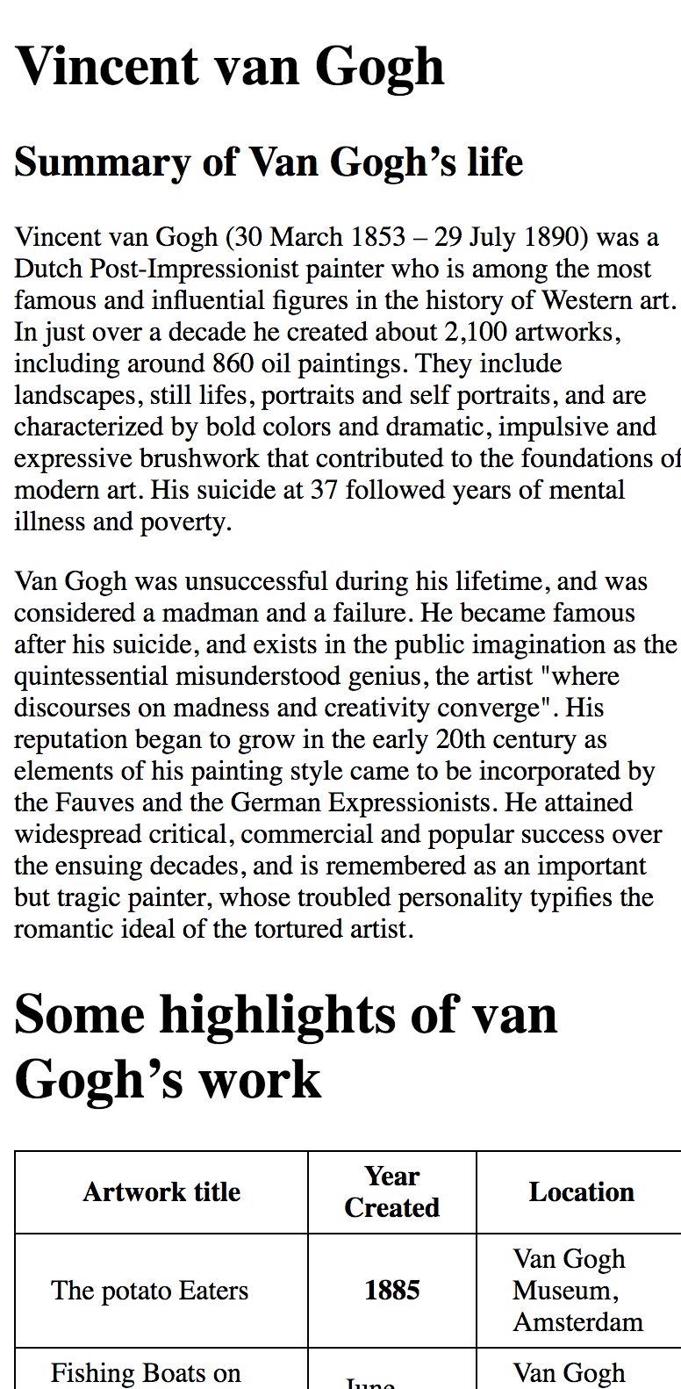
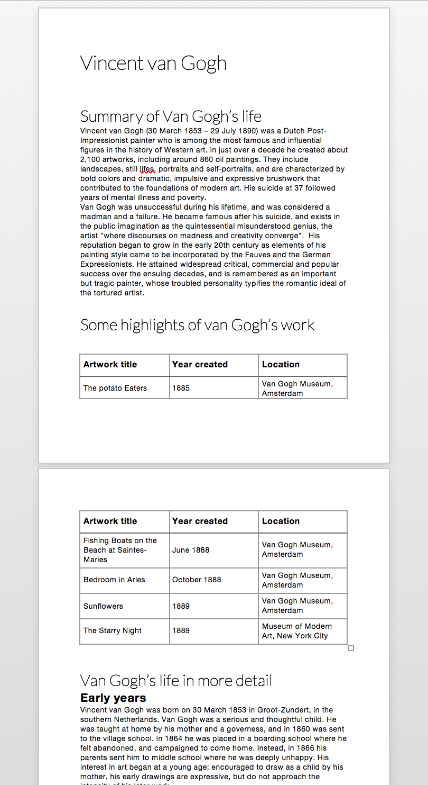
Example 6: Mobile Use

Slide 16
Universal Design
Accessibility is about providing better access to everyone
Accessibility improvements leads to higher quality and more usable content that can benefit all students

Slide 17
Accessibility ≠ Disability

Slide 18
Accessibility ⊃ Disability
It affects all students

Slide 19
Example

Slide 20
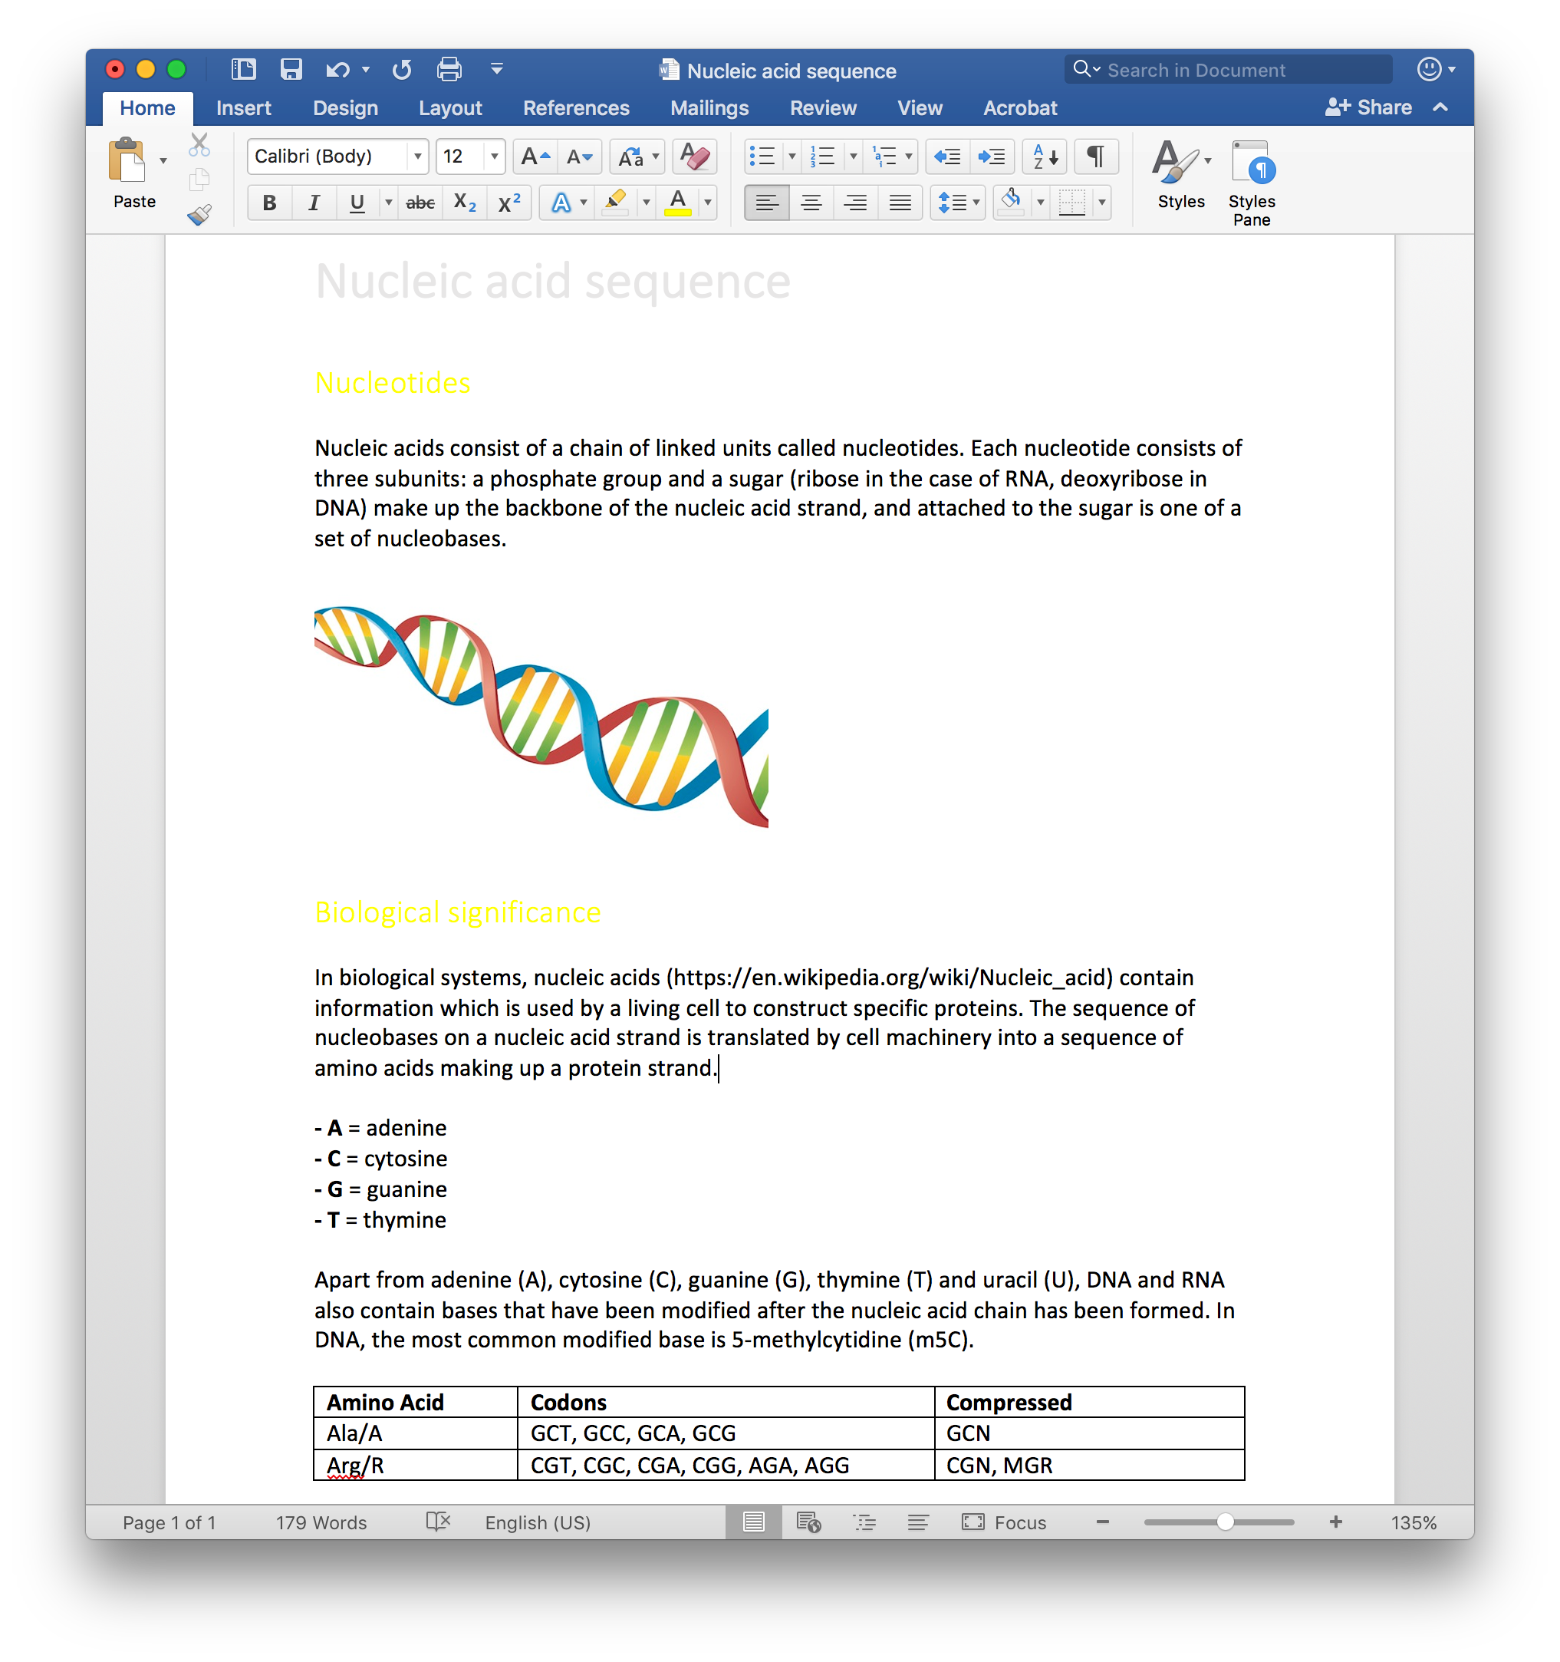
Example Document

Slide 21
Beyond the visuals
We derive a lot of meaning from visuals, but computer is unable to see
Semantics are very important for accessibility
Computer is intermediary
Using appropriate semantics makes computer understand structure

Slide 22
Audio
Show how computer sees content
Also how a screenreader works
Close your eyes and follow along

Slide 23


Audio
Notes:
Ask audience what they thought about that

Slide 24
Example Document
Nucleic acid sequence Nucleotides Nucleic acids consist of a chain of linked units called nucleotides. Each nucleotide consists of three subunits: a phosphate group and a sugar (ribose in the case of RNA, deoxyribose in DNA) make up the backbone of the nucleic acid strand, and attached to the sugar is one of a set of nucleobases. Biological significance In biological systems, nucleic acids contain information which is used by a living cell to construct specific proteins. The sequence of nucleobases on a nucleic acid strand is translated by cell machinery into a sequence of amino acids making up a protein strand. A = adenine C = cytosine G = guanine T = thymine
Apart from adenine (A), cytosine (C), guanine (G), thymine (T) and uracil (U), DNA and RNA also contain bases that have been modified after the nucleic acid chain has been formed. In DNA, the most common modified base is 5-methylcytidine (m5C). Amino Acid Codons Compressed Ala/A GCT, GCC, GCA, GCG GCN Arg/R CGT, CGC, CGA, CGG, AGA, AGG CGN, MGR

Slide 25
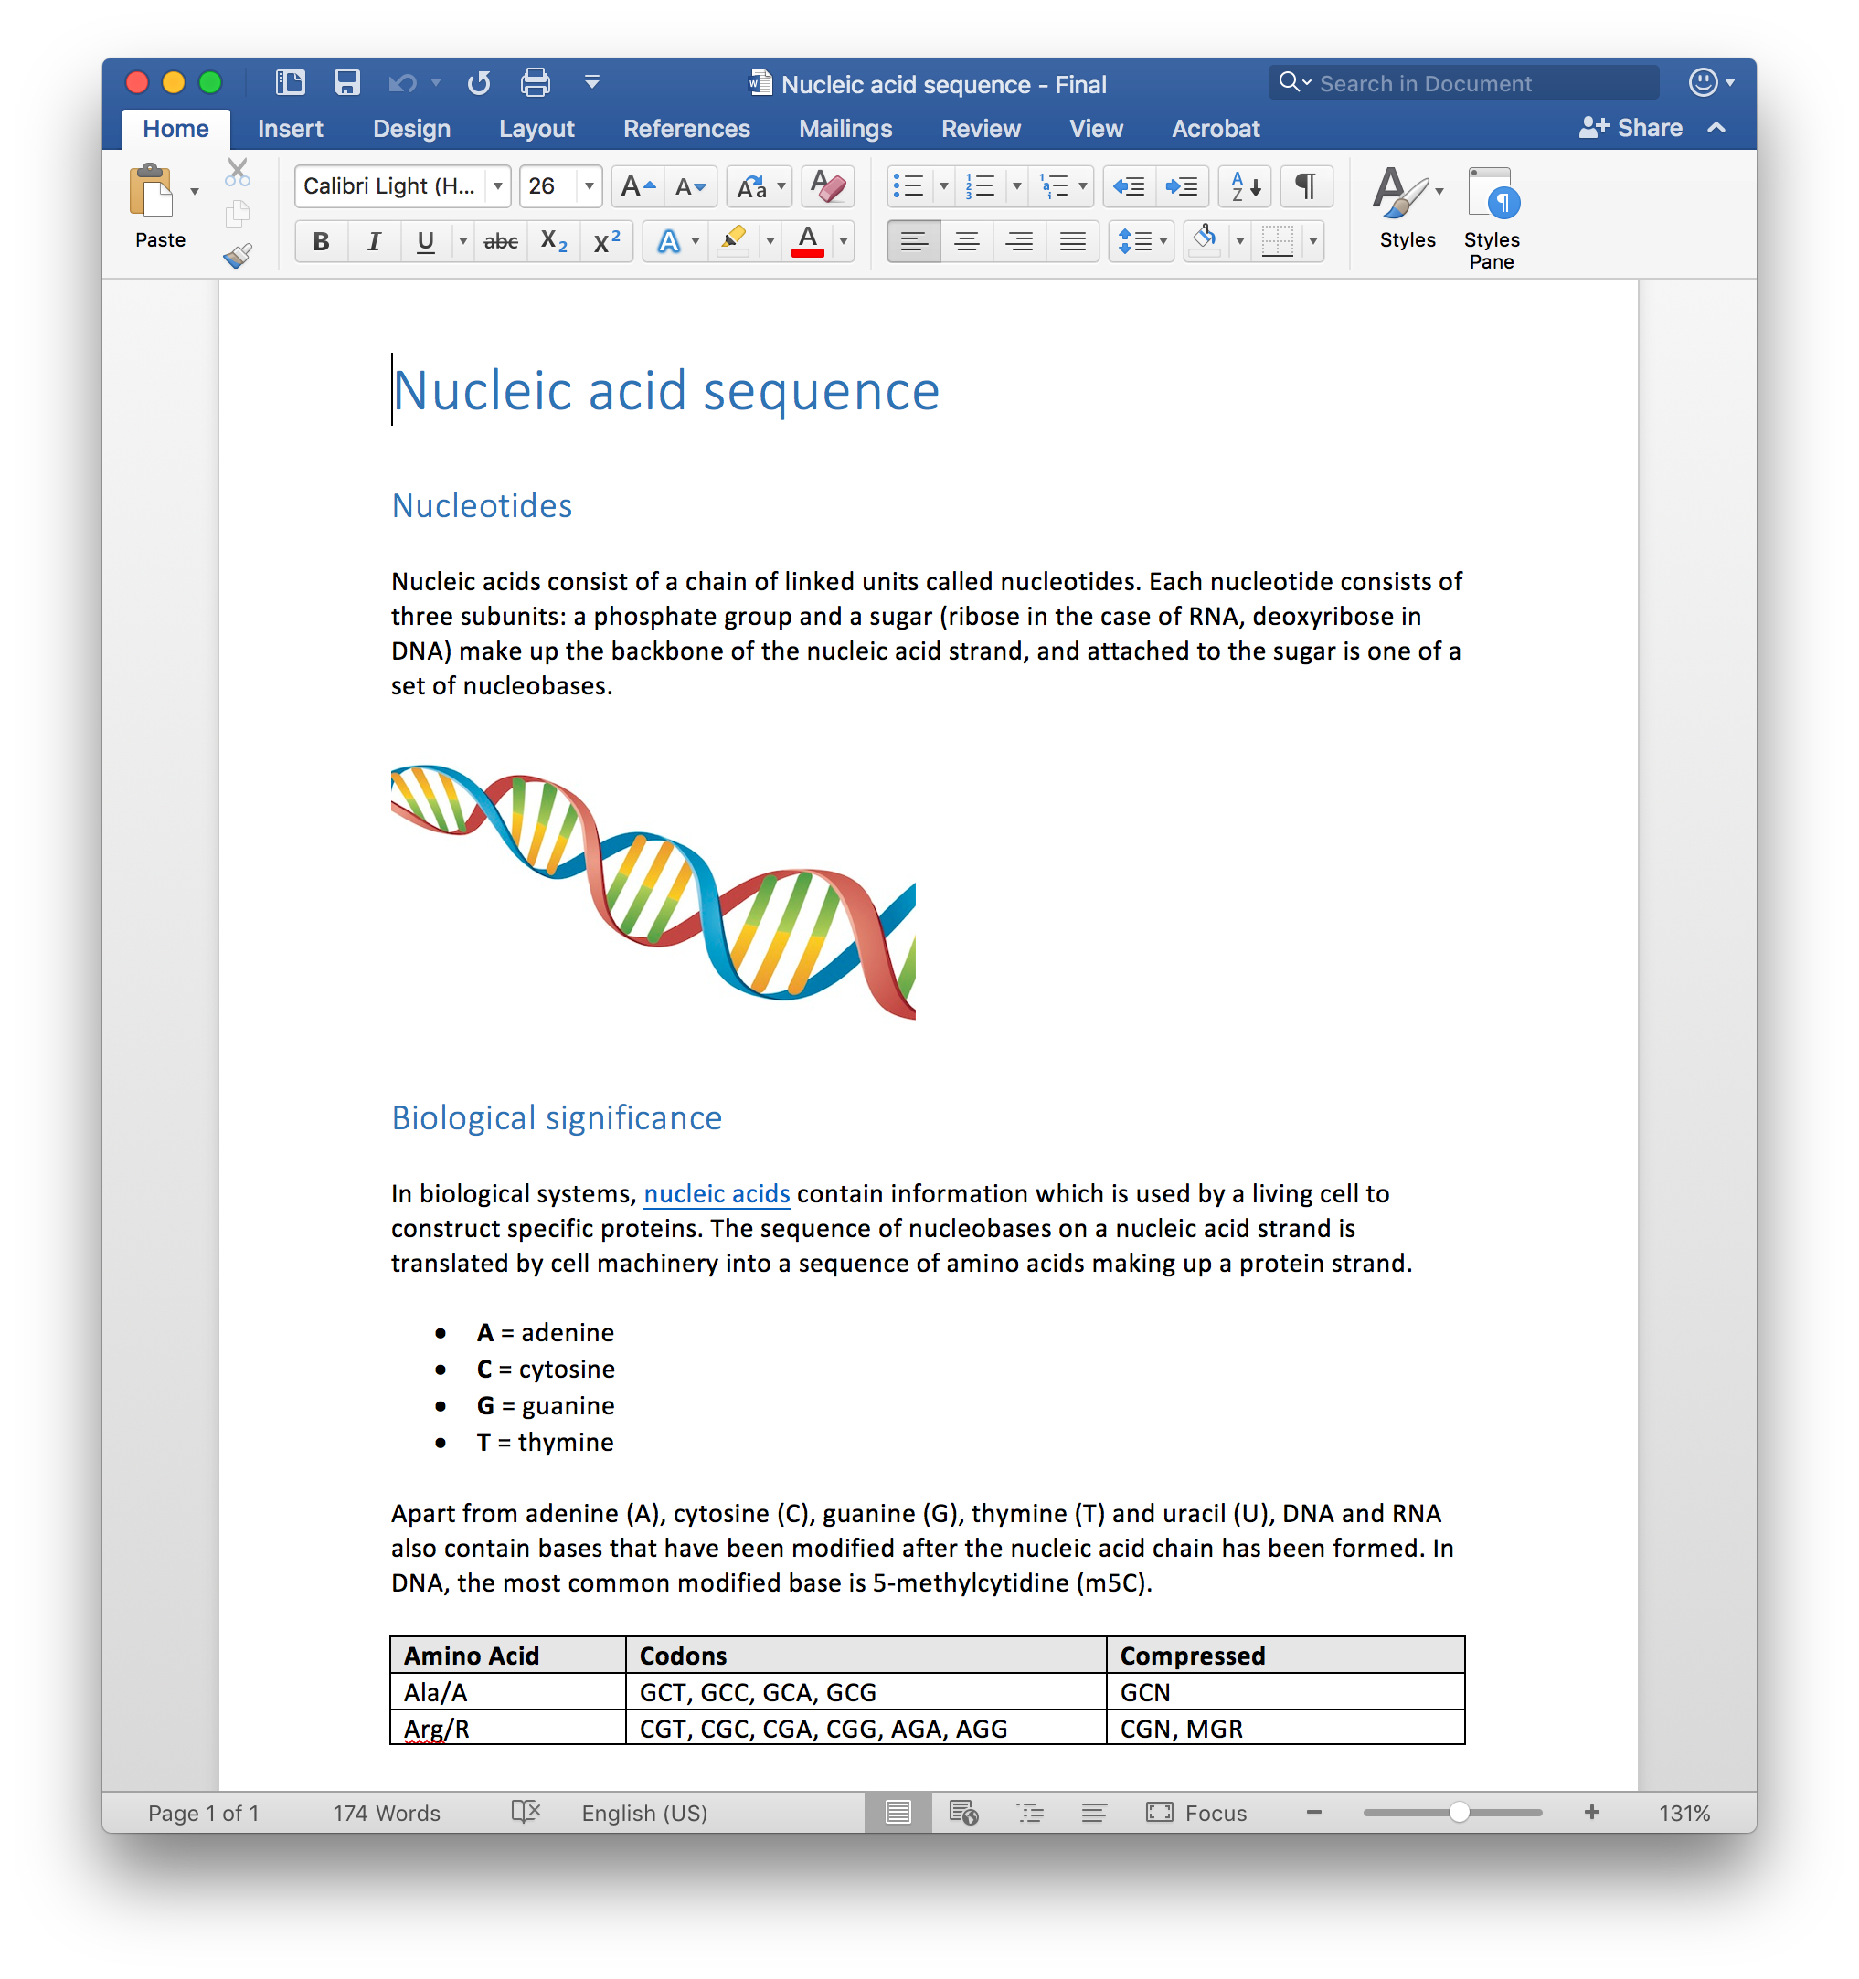
Improved Example Document

Slide 26
Improved Example Document
Notes:
Ask audience what they thought about that

Slide 27
Improved Example Document
Nucleic acid sequence
Nucleotides Nucleic acids consist of a chain of linked units called nucleotides. Each nucleotide consists of three subunits: a phosphate group and a sugar (ribose in the case of RNA, deoxyribose in DNA) make up the backbone of the nucleic acid strand, and attached to the sugar is one of a set of nucleobases.
IMAGE: A series of codons in part of a mRNA molecule. Each codon consists of three nucleotides, usually representing a single amino acid. Biological significance In biological systems, nucleic acids contain information which is used by a living cell to construct specific proteins. The sequence of nucleobases on a nucleic acid strand is translated by cell machinery into a sequence of amino acids making up a protein strand.
A = adenine
C = cytosine
G = guanine
T = thymine

Slide 28
Improved Example Document
Apart from adenine (A), cytosine (C), guanine (G), thymine (T) and uracil (U), DNA and RNA also contain bases that have been modified after the nucleic acid chain has been formed. In DNA, the most common modified base is 5-methylcytidine (m5C).
Amino Acid | Codons | Compressed
Ala/A | GCT, GCC, GCA, GCG | GCN
Arg/R | CGT, CGC, CGA, CGG, AGA, AGG | CGN, MGR

Slide 29
Benefits
Now that the computer understands the structure and semantics, more can be done with the content:
Automatically convert to alternative formats (audio, ePub, Braille, etc.)
Works much better with assistive technology
Generate meaningful Table of Contents, outline, etc.
Works better on mobile devices
Easier maintenance
etc.

Slide 30
How are we doing today?

Slide 31
Data Study
Large scale data study
20 Higher Education institutions
Up to 5 years of data per institution
21+ million content items
700,000+ courses
Looks at all courses in institution

Slide 32
Content Type Distribution

Slide 33
Content Type Distribution
Most common content types are Image and PDF
Not a great starting point for accessibility
Significant institutional differences
Can be skewed by courses with lots of unusual content

Slide 34
Scanned Documents (Per Institution)

Slide 35
Scanned Documents (Trend)

Slide 36
Scanned Documents (Trend)
Very minor overall downward trend
Some institution are improving significantly
Strong connection with institutional initiatives

Slide 37
Untagged PDFs (Per Institution)

Slide 38
Untagged PDFs (Trend)

Slide 39
Untagged PDFs (Trend)
Slight but consistent overall downward trend
Software improvements?
Quite a large band
Institutional licensing decisions?
Doesn’t say anything about the quality of the tags yet

Slide 40
Headings - Documents (Trend)

Slide 41
Headings - Presentations (Trend)

Slide 42
Headings (Trend)
About half of the documents is flagged as not using headings correctly, while only roughly 1 in 5 presentations is flagged as not using headings correctly
Thanks to built-in slide templates
Institutional content templates can be very effective
Make sure the institutional content templates are accessible. Otherwise, the problem can become significantly worse

Slide 43
Images Without An Alternative Description (Trend)

Slide 44
Images Without An Alternative Description (Trend)
Over 75% of images don’t have an alternative description
Deteriorating slightly over time
Many systems now set file name as default alt text

Slide 45
Documents With Contrast Issues (Per Institution)

Slide 46
Documents With Contrast Issues (Trend)

Slide 47
Documents With Contrast Issues (Trend)
Roughly 1 in 3 documents is flagged as having contrast issues
Consistent across institutions with no noticeable improvement

Slide 48
Accessibility Score
Every individual item has an accessibility score
Score between 0 and 100
Weighted average of the results from accessibility checklist
Reflect how accessible the item is, how many students it affects and/or how critically it affects them
Course accessibility score & institution accessibility score

Slide 49
Overall Accessibility Score (Per Institution)

Slide 50
Overall Accessibility Score (Trend)

Slide 51
Overall Accessibility Score (Trend)
Minor overall improvement in last 5 years
Some institution have clear upward trend. Others are flat or even declining.
Strong connection with institutional initiatives
At the current pace, it will take another 20 years to get to 50%

Slide 52
Conclusion
Things are getting better, but not by much
Problem is not going to fix itself or go away anytime soon
Need to find ways to make progress faster
Work with vendors to make existing tools better at creating accessible content
Space for new tools to help make content more accessible
Need to find ways to raise awareness and visibility with content creators
Institutional engagement can pay off
Institutional initiatives are often reflected in numbers

Slide 53
What can we do today?

Slide 54
What can we do today?
Creating accessible content is about
using the tools correctly
following a set of general guidelines
Low effort universal guidelines that can be applied to all authoring software
Achievable goals!

Slide 55
1. Font Size
Use a large enough font size
Easier to read for everyone
14px is recommended minimum size

Slide 56
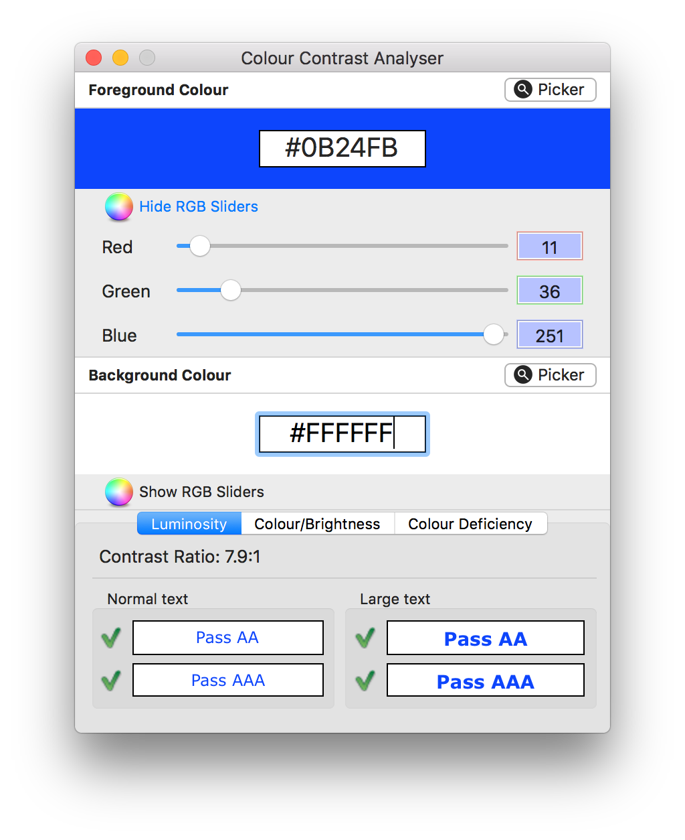
2. Color Contrast
Low contrast between text and its background can make content difficult to read for everyone
Determining acceptable colour contrast is easy
Colour Contrast Checker: https://www.paciellogroup.com/resources/contrastanalyser/

Slide 57
3. Headings
One of the most important accessibility considerations
Logical and consistent headings are critical for providing structure to a document
Especially longer documents
Makes document easier to understand and navigate
Use built-in heading styles
Don’t use bold, italic, underline, colour or font size to emulate headings
Provides additional benefits
Consistency
Automated generation of Table of Contents
Algorithmic possibilities

Slide 58
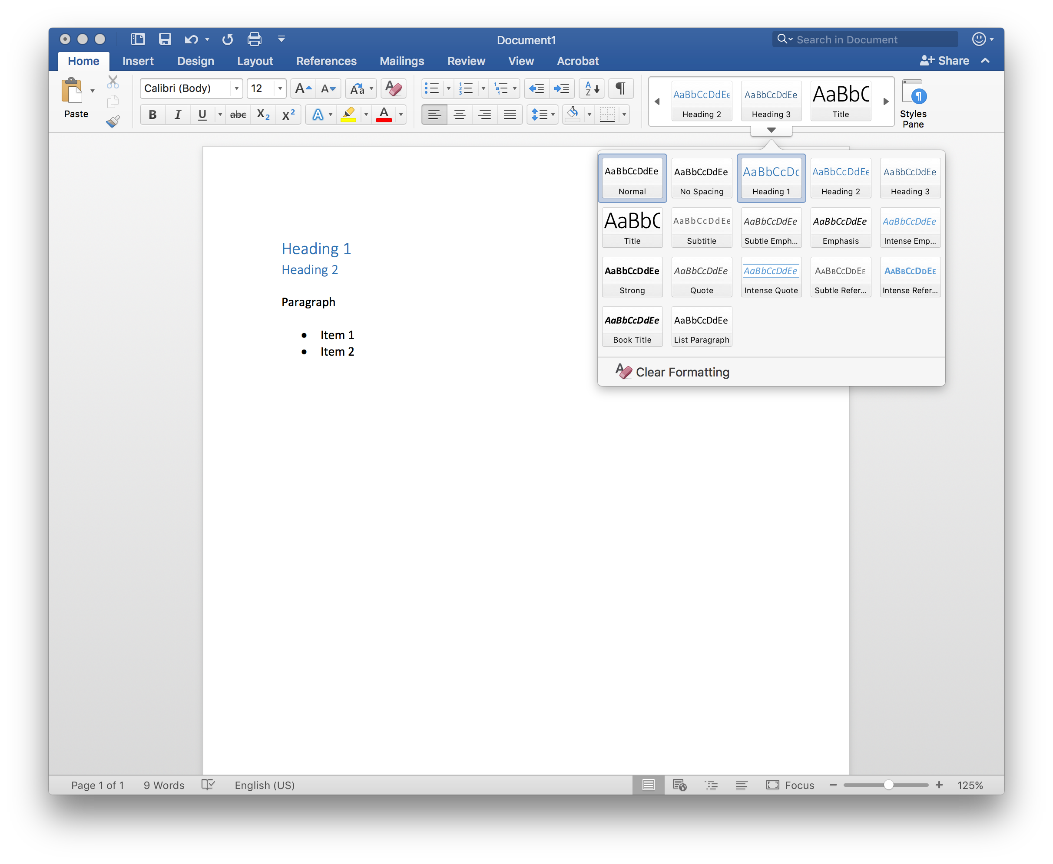
3. Headings

Slide 59
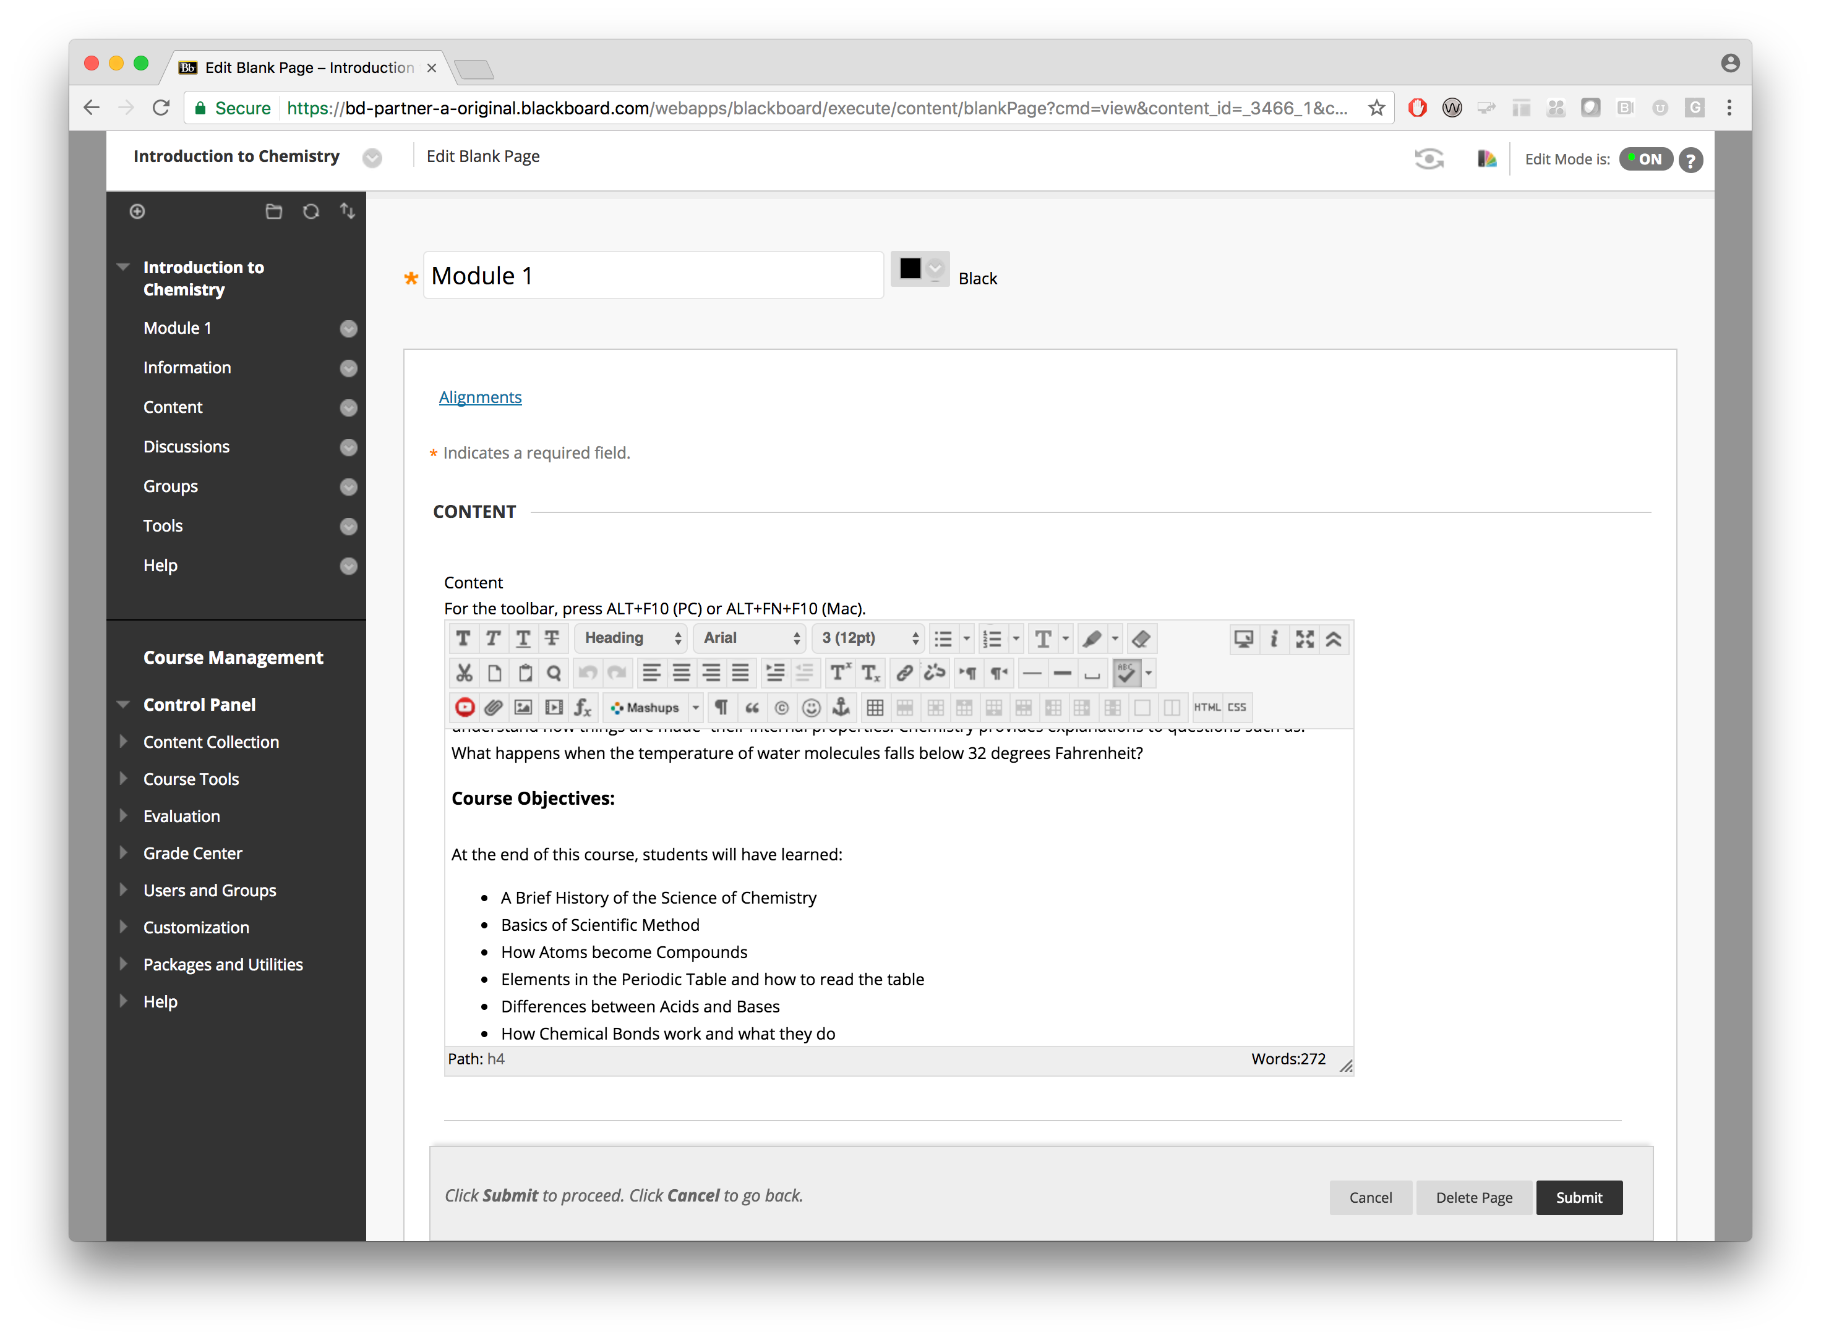
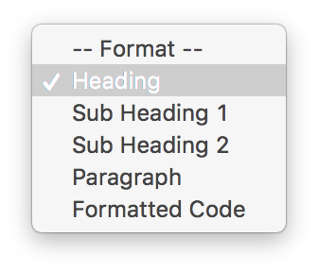
3. Headings
Set your cursor to the line that you want to convert to a heading
Open the “Font Style” dropdown.
NOTE: This will usually say “Paragraph” as this is the default style
Select the desired heading level (“Heading”, “Sub Heading 1” or “Sub Heading 2”)

Slide 60
3. Headings: Powerpoint
Powerpoint contains highly accessible slide layouts
Using these correctly is most significant thing you can do for accessibility
Ensures proper structure, reading order, etc.

Slide 61
4. Images
An image should have a quality alternative description
Screen readers and other assistive technologies can’t convert images into words
Benefits of having alternative description:
Easier to search and find
Help student understand content and its connection to context
Provide access to content for visually impaired students
Allow conversion to audio formats

Slide 62
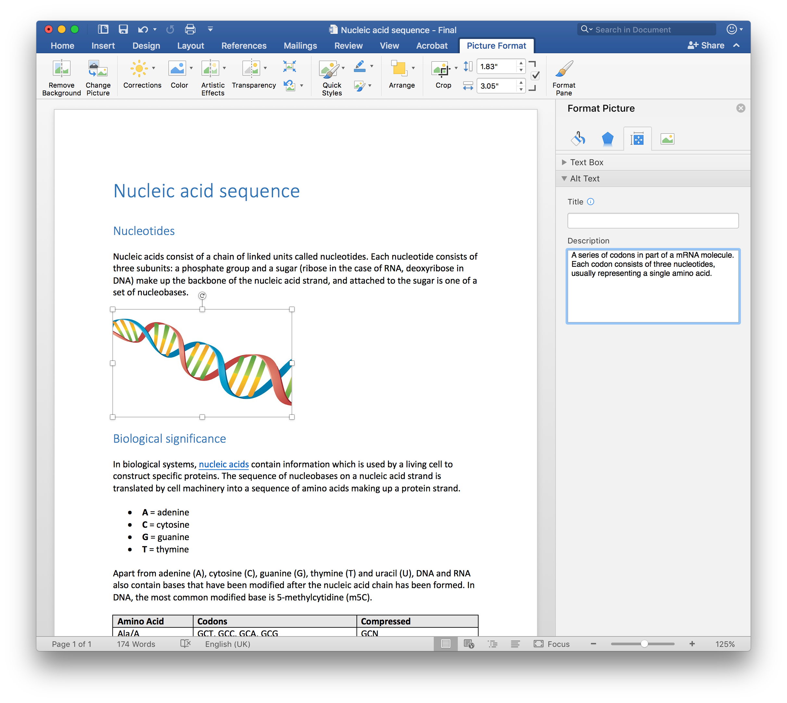
4. Images

Slide 63
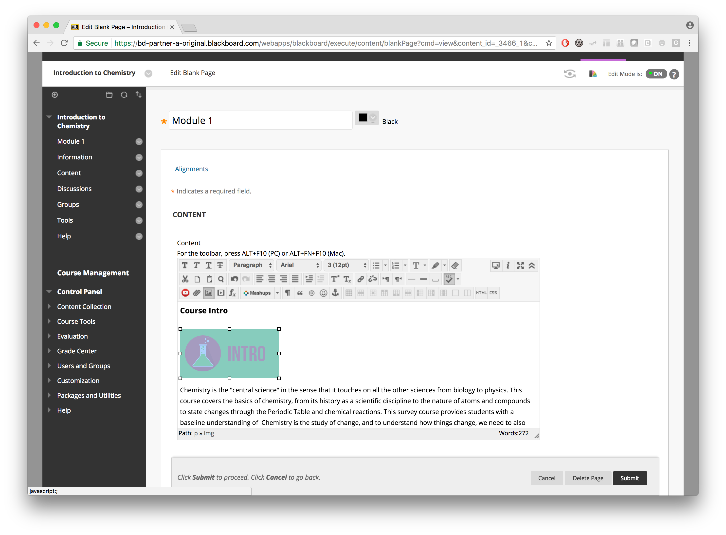
4. Images
Select the image you want to provide alternative text for
Click the “Insert / Edit Image” button

Slide 64
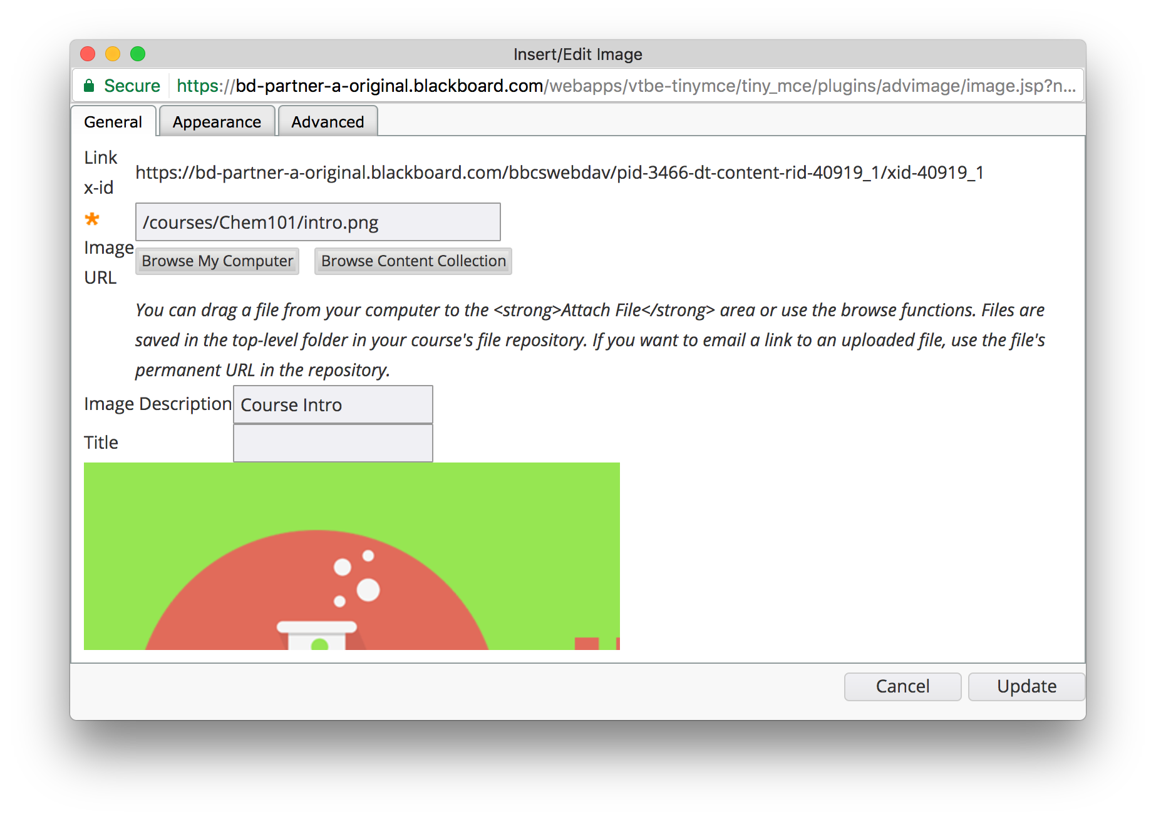
4. Images
Enter a quality description for the image under “Image Description”
Click the “Update” button

Slide 65
5. Tables
Only use tables for tabular data
Don’t use tables for layout purposes
Always include column headings
Makes table easier to read
Much easier to work through using a screenreader or other assistive technologies

Slide 66
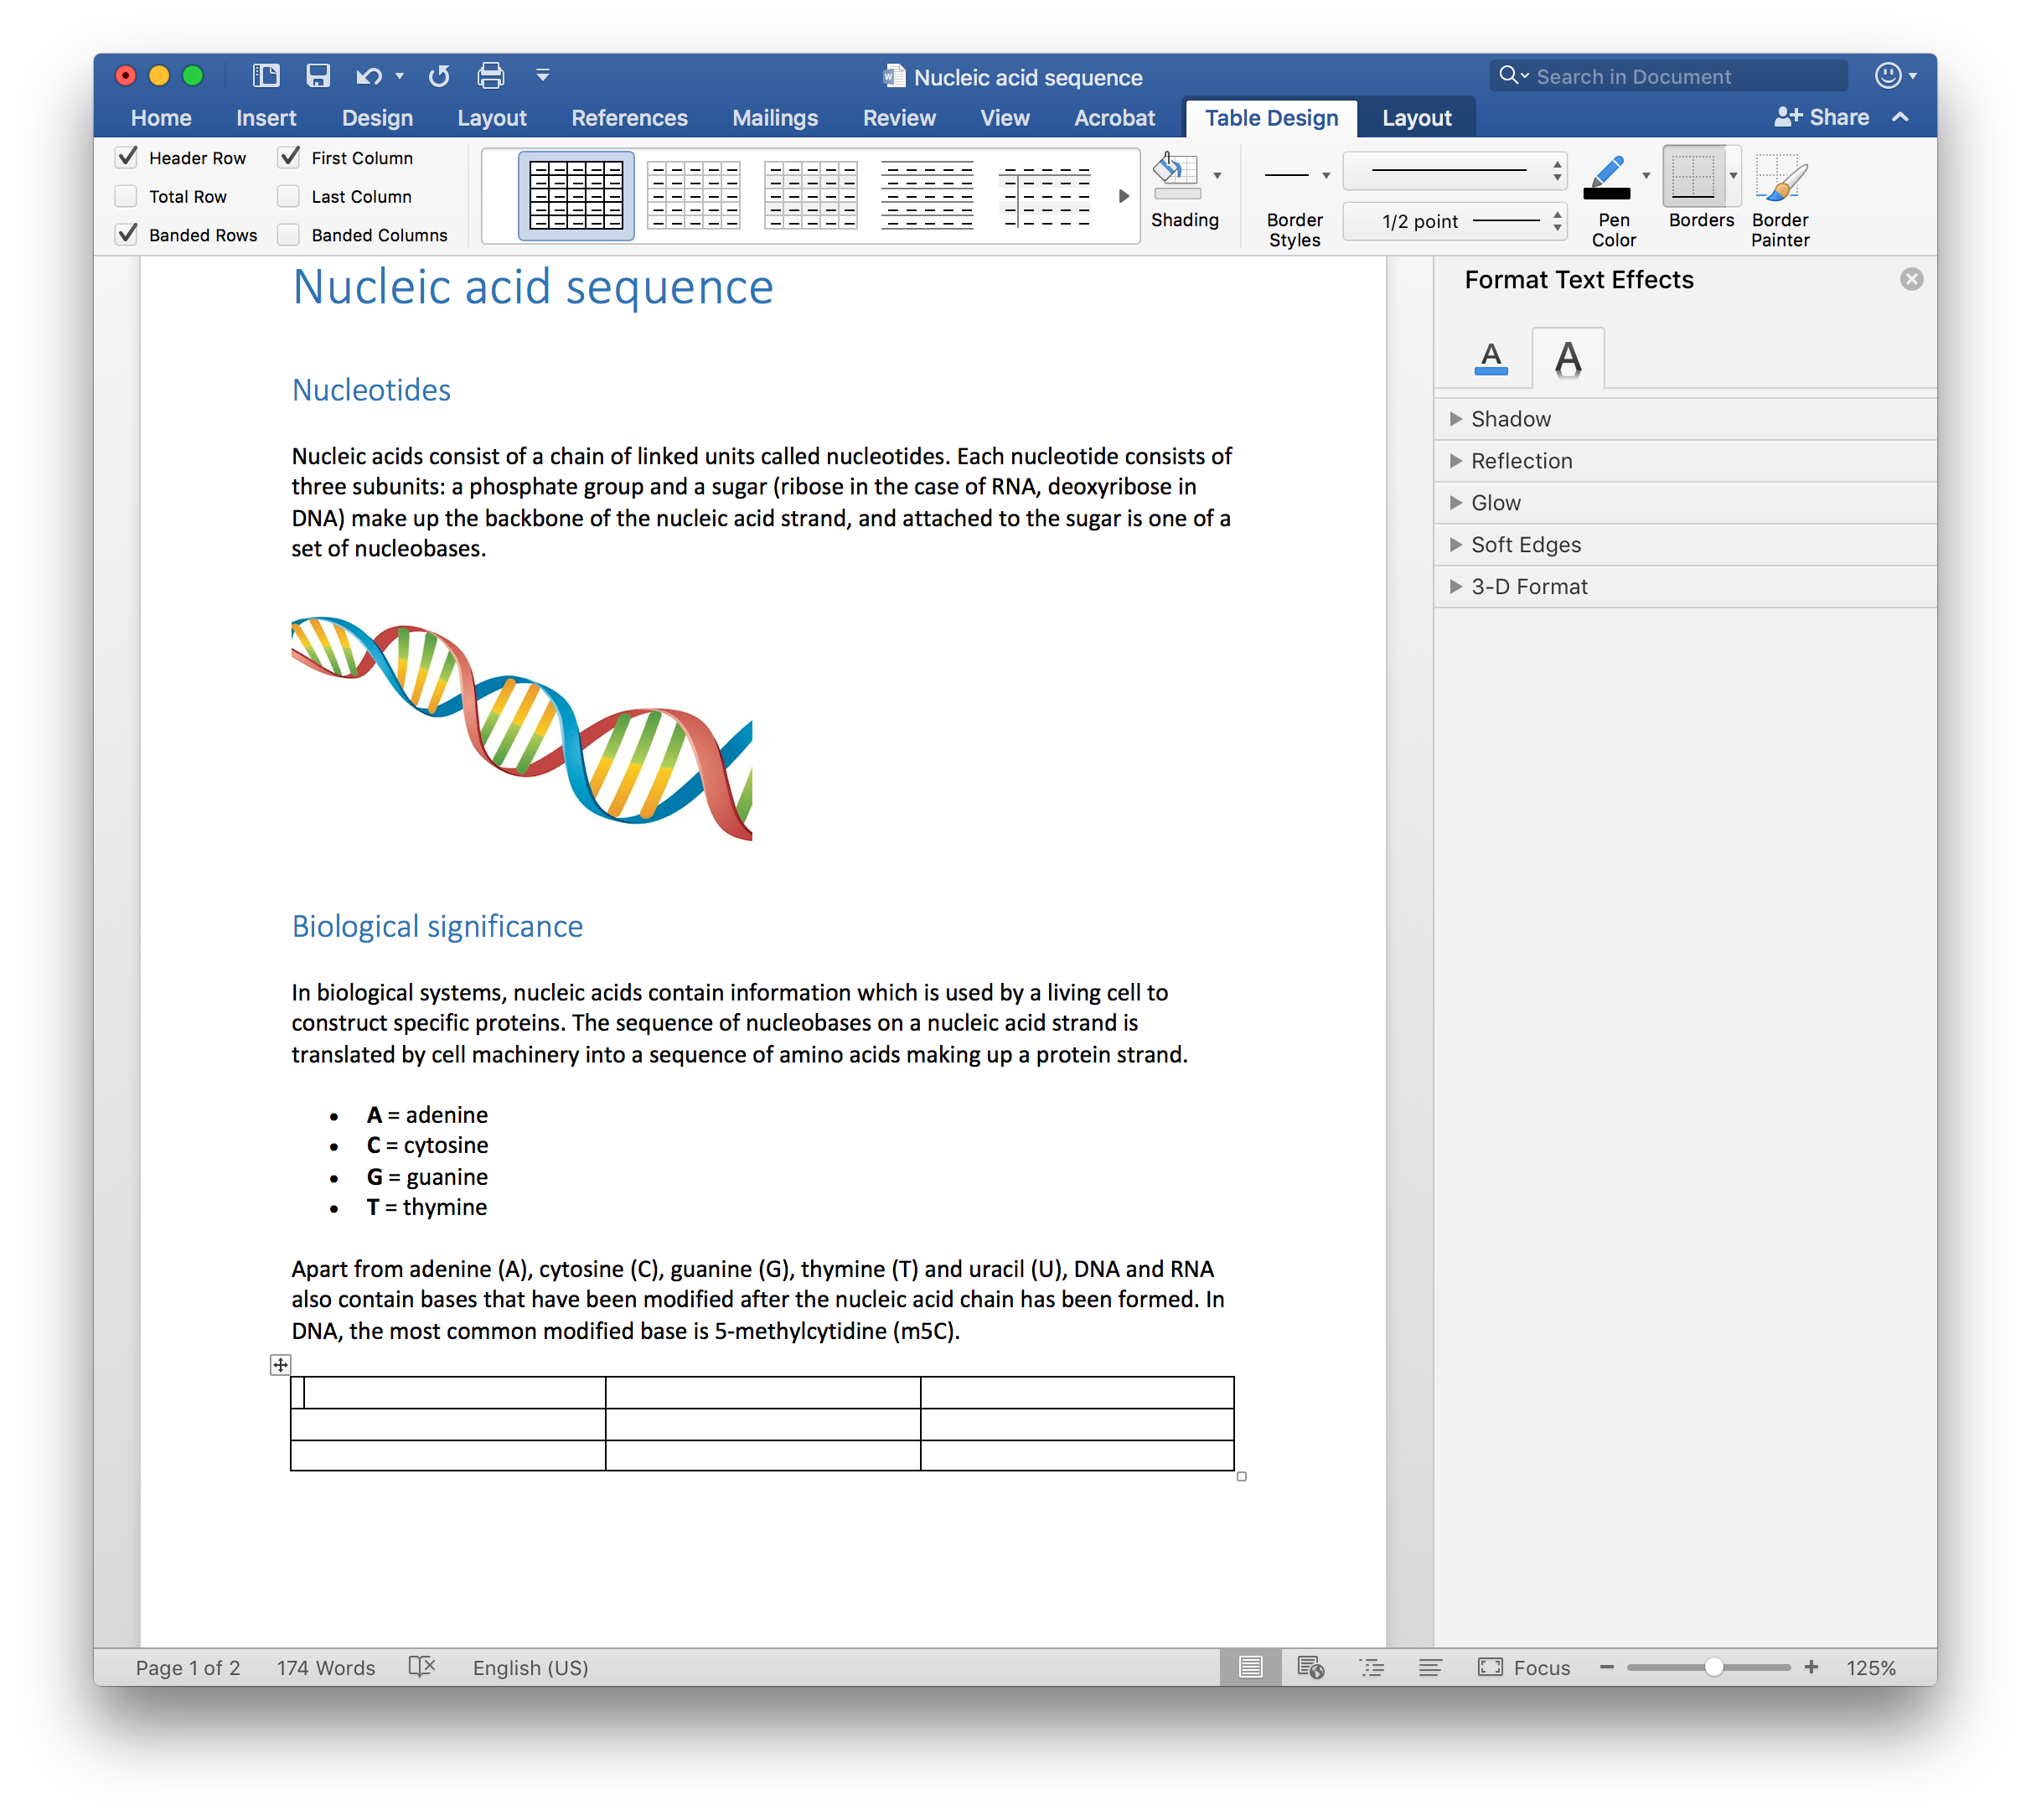
5. Tables

Slide 67
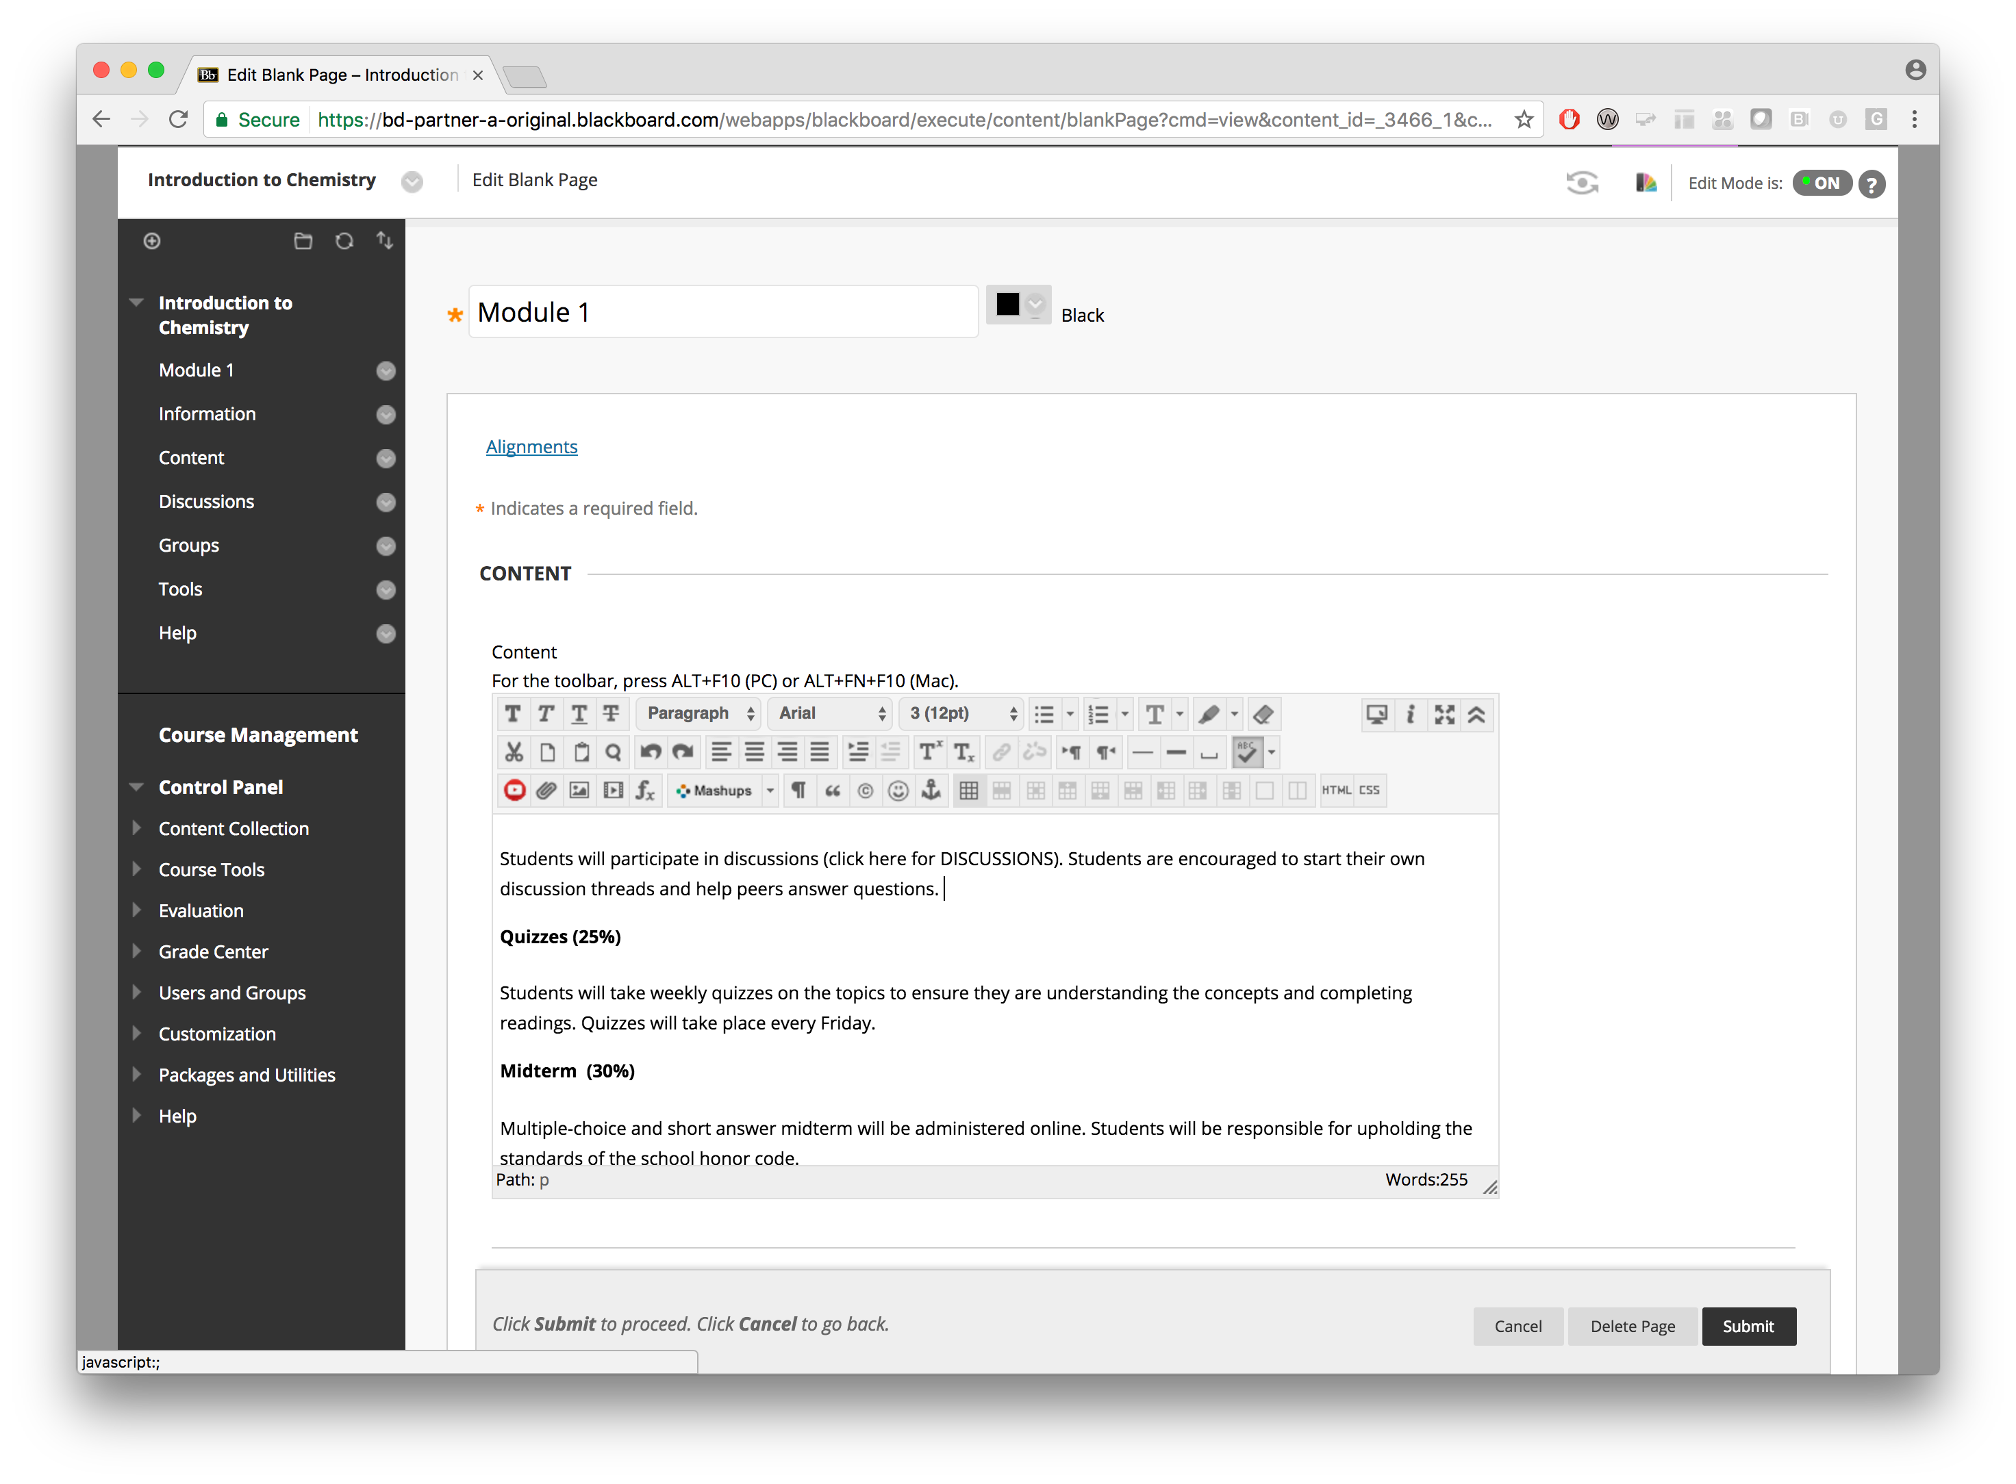
5. Tables
Set the cursor to where you want to insert a table
Click the “Insert/Edit Table” button.

Slide 68
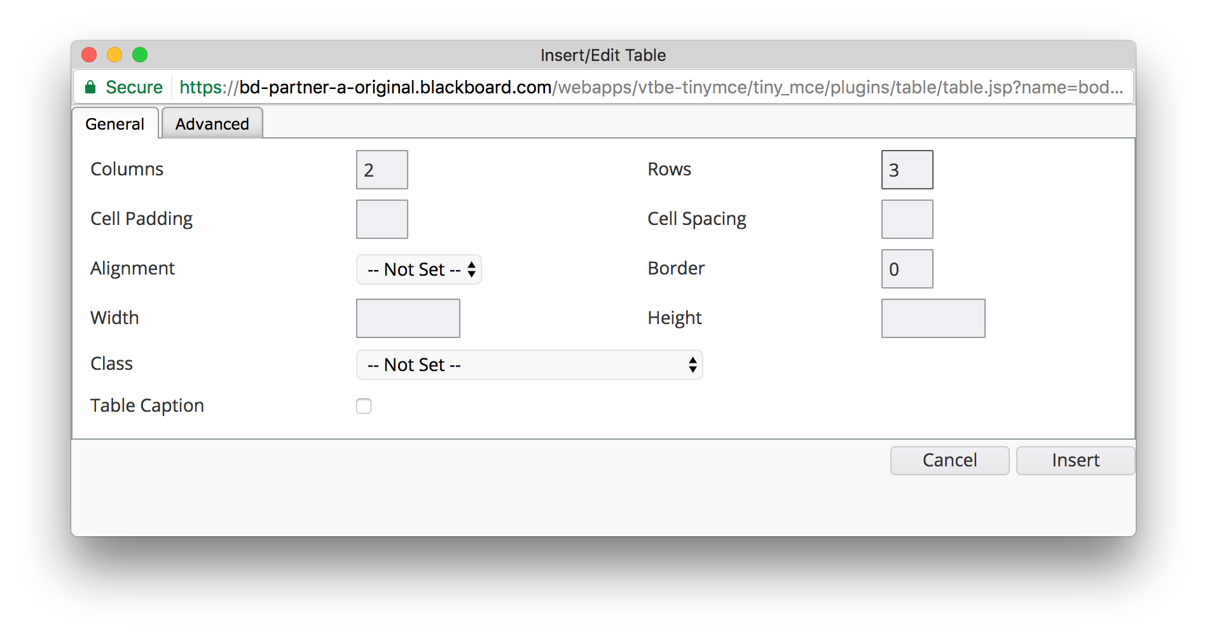
5. Tables
Enter the desired number of rows and columns.
NOTE: The number of rows and columns can be adjusted at any time

Slide 69

5. Tables
In order to set the first row as the table headers, set your cursor in one of the cells of the first row.
Click the “Table Row properties” button.

Slide 70
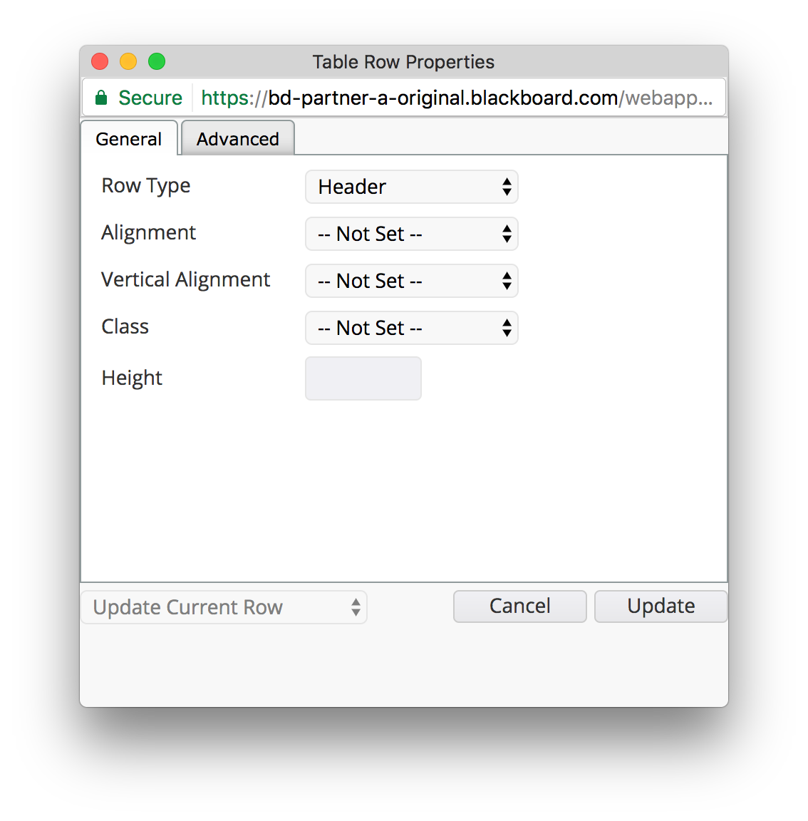
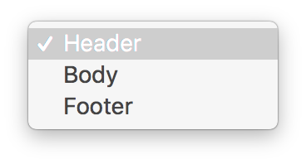
5. Tables
Select “Header” under “Row type”
The cells in the first row should now act as headings for their columns

Slide 71
6. Lists
An enumeration of items should be marked up as list
Use built-in list functionality
Don’t emulate lists through special characters

Slide 72
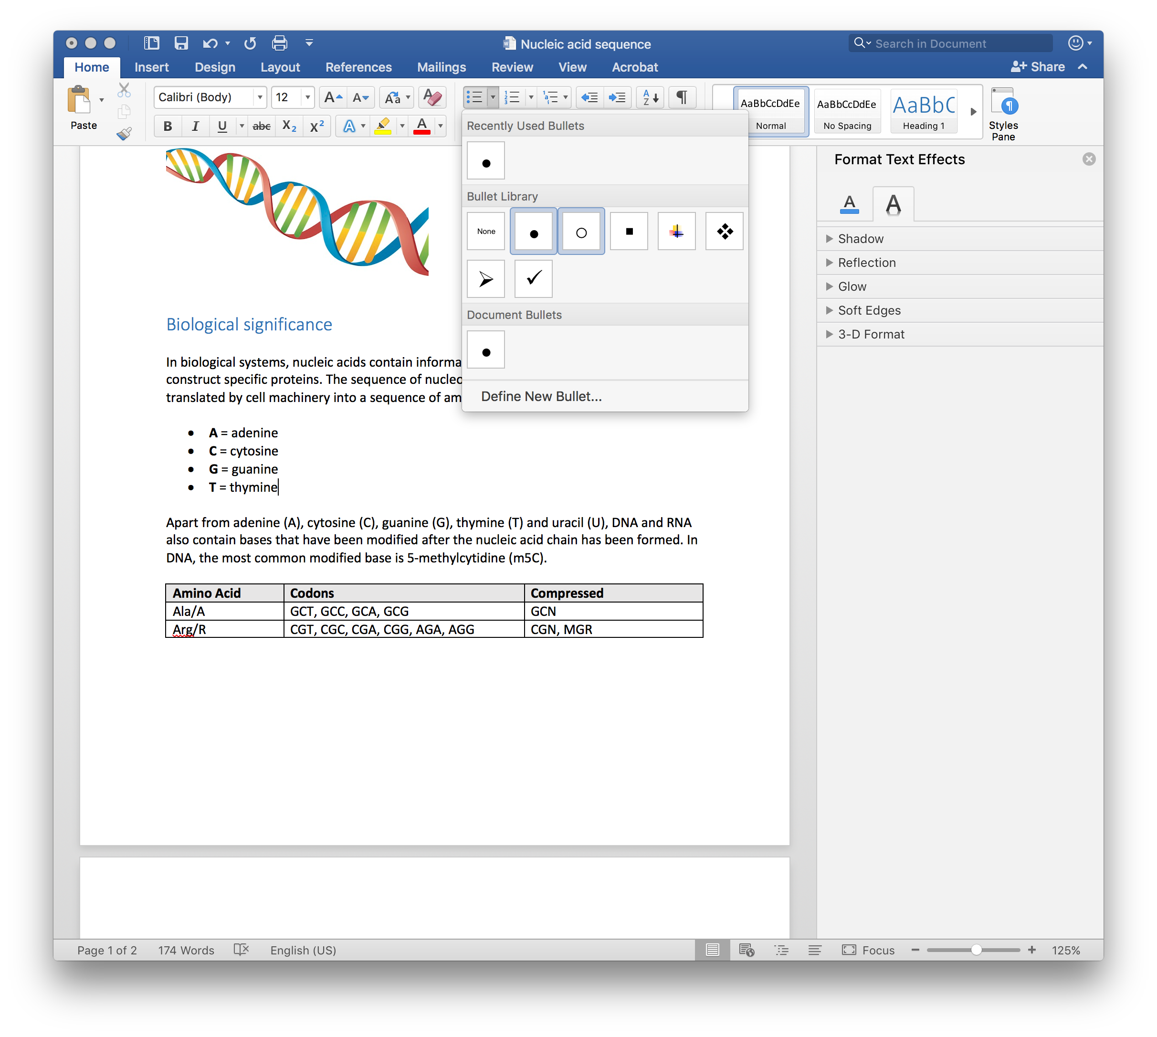
6. Lists

Slide 73
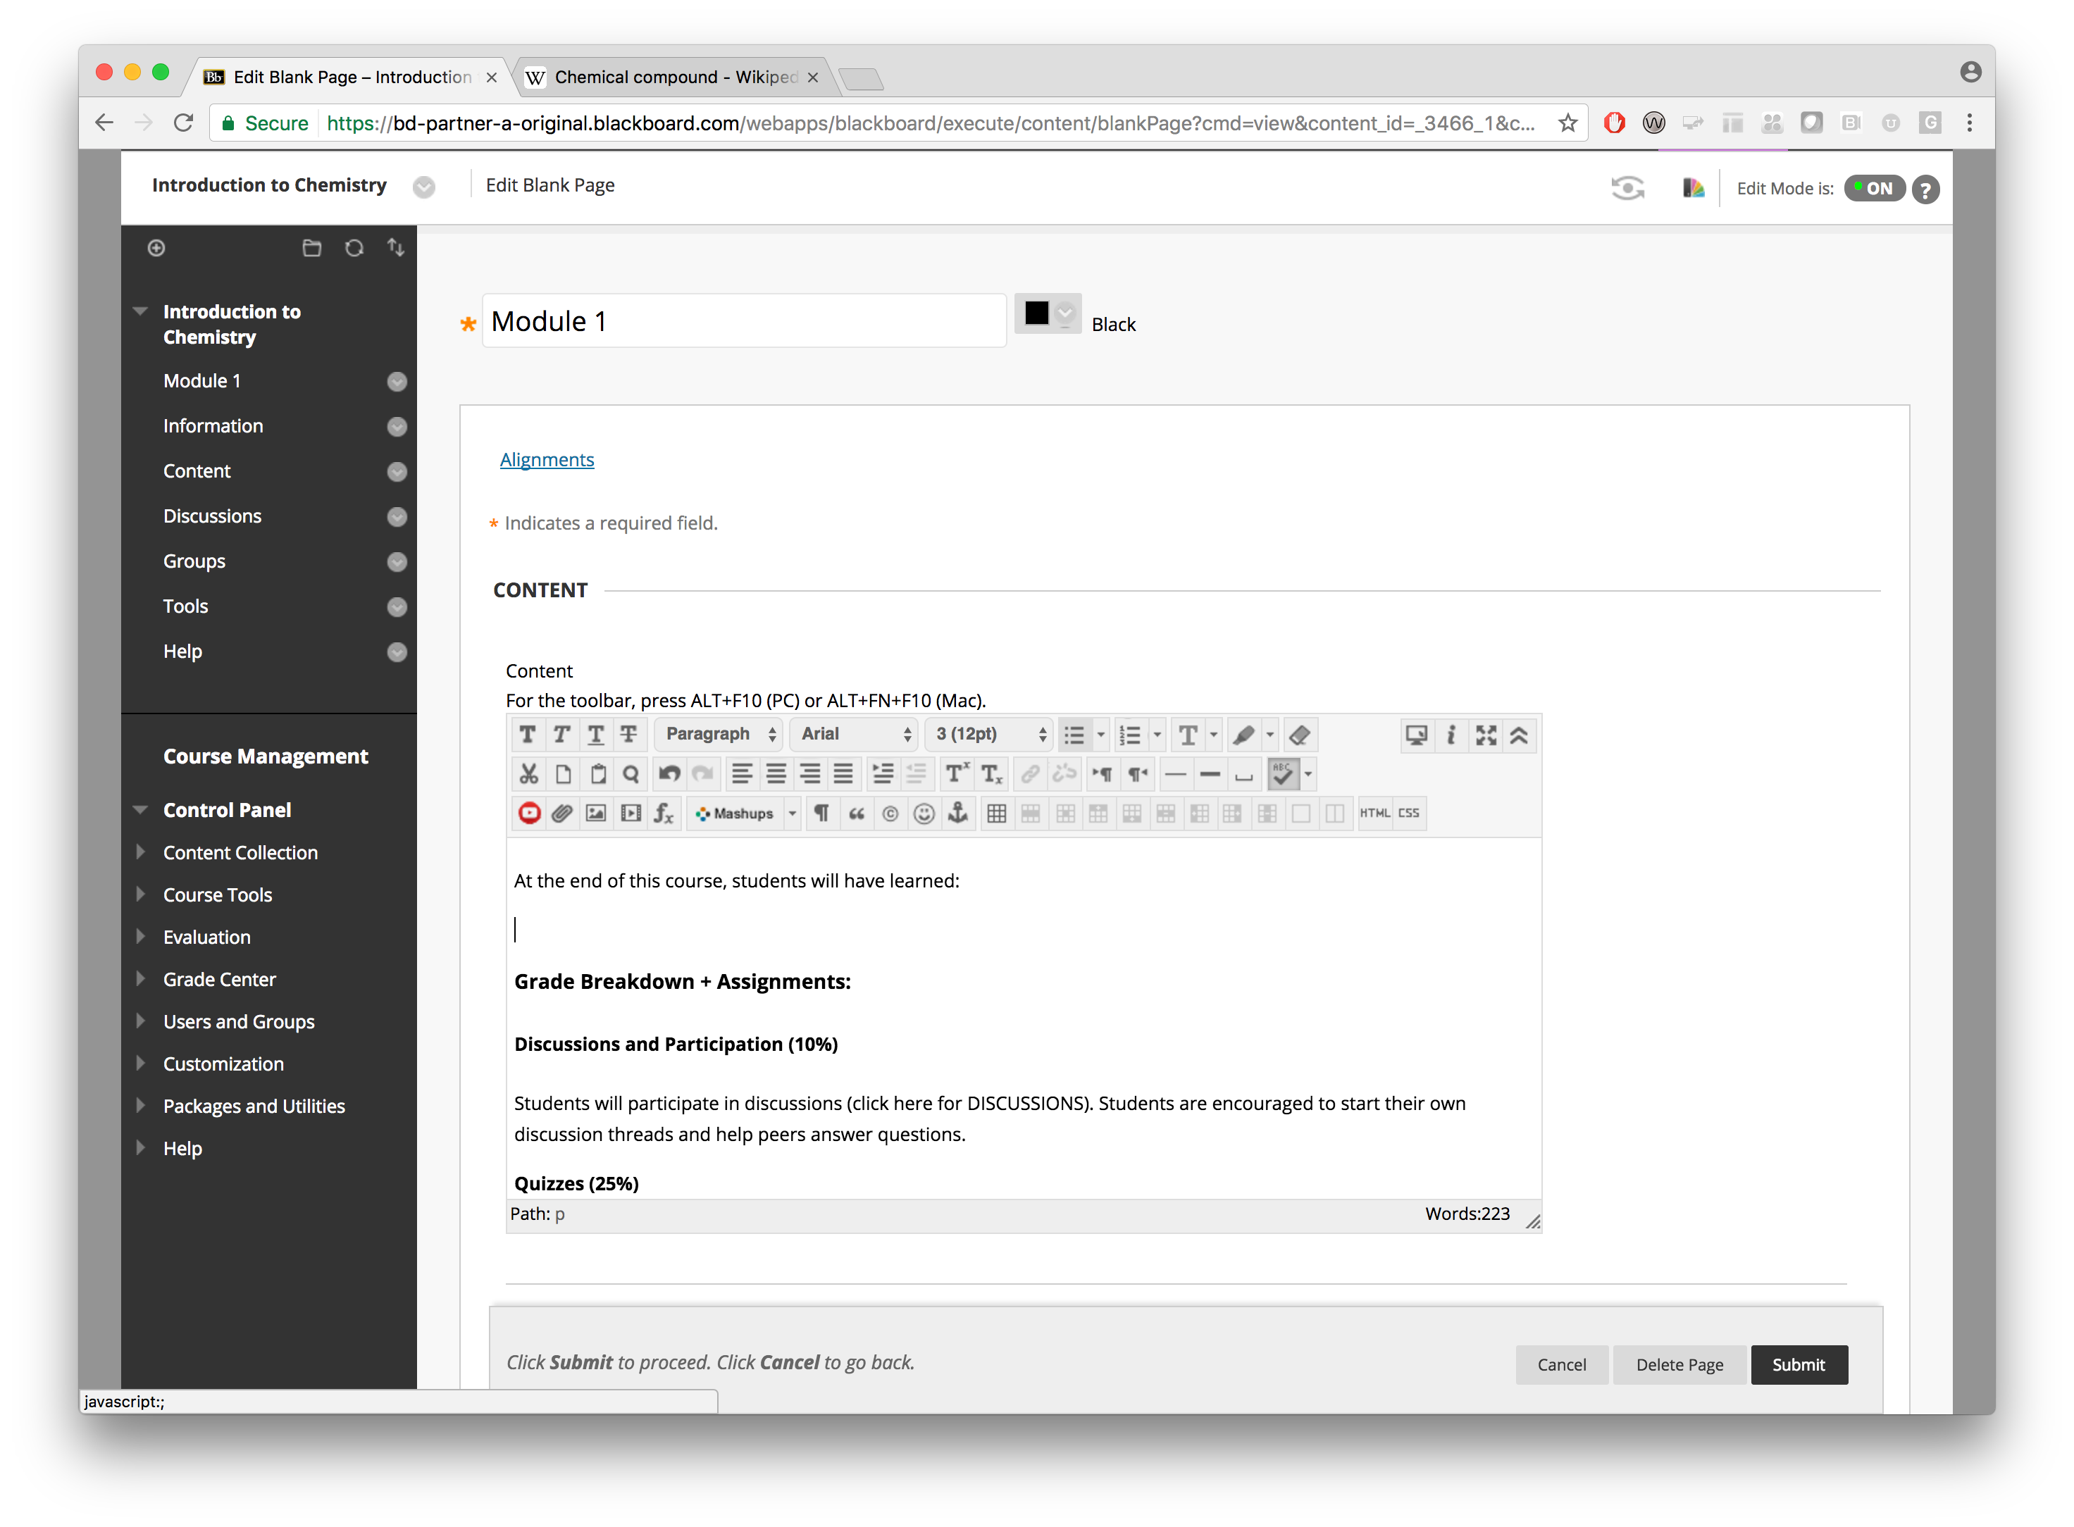
6. Lists
Set the cursor to where you want to insert the list
Click the “Bullet list” button to start a bulleted list or the “Number list” button to start a numbered list

Slide 74

6. Lists
Enter the list item
Hit “Enter” to start the next list item
Hit “Enter” twice to stop the list

Slide 75
7. Links
Links should be marked up as actual links
The link should have text that describes the target
Context about the link
Friendlier for screen readers and assistive devices

Slide 76
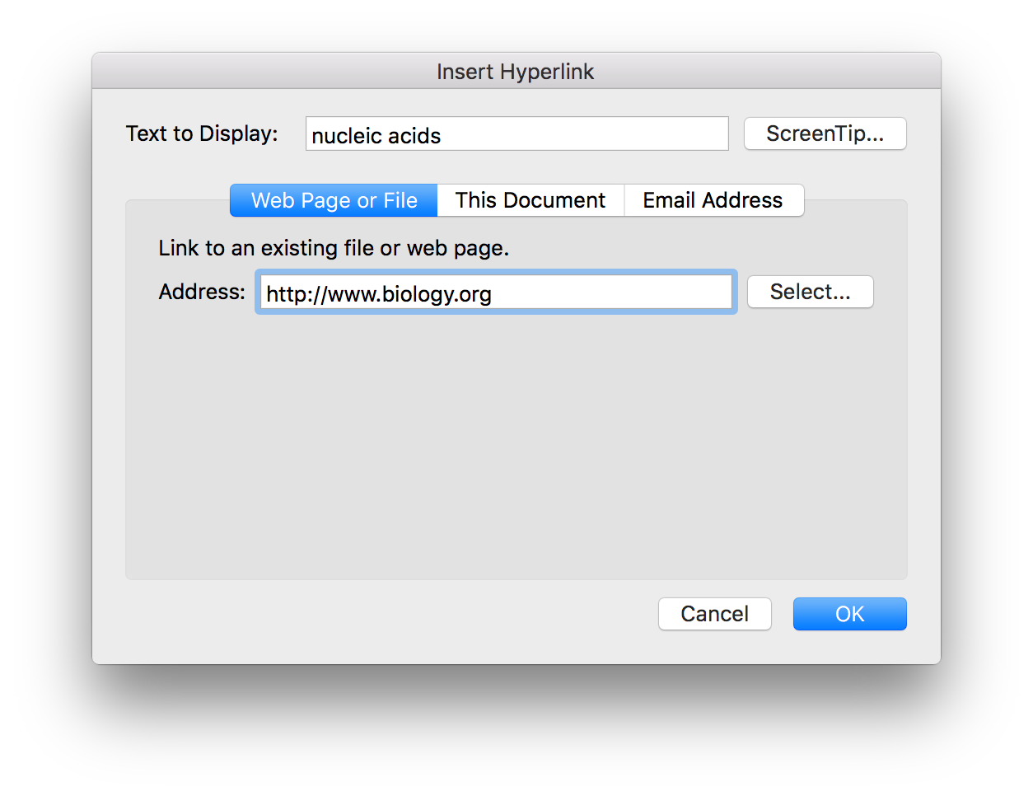
7. Links

Slide 77
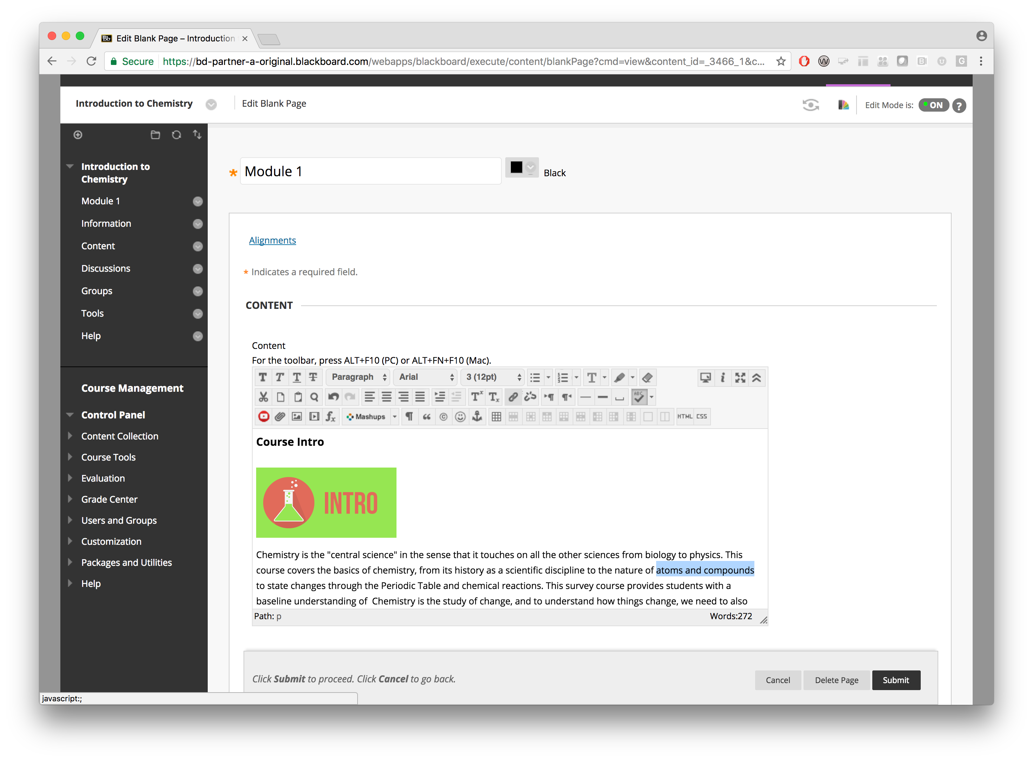
7. Links
Select the text you want to convert into a clickable link
Click the “Insert/Edit Link” button

Slide 78
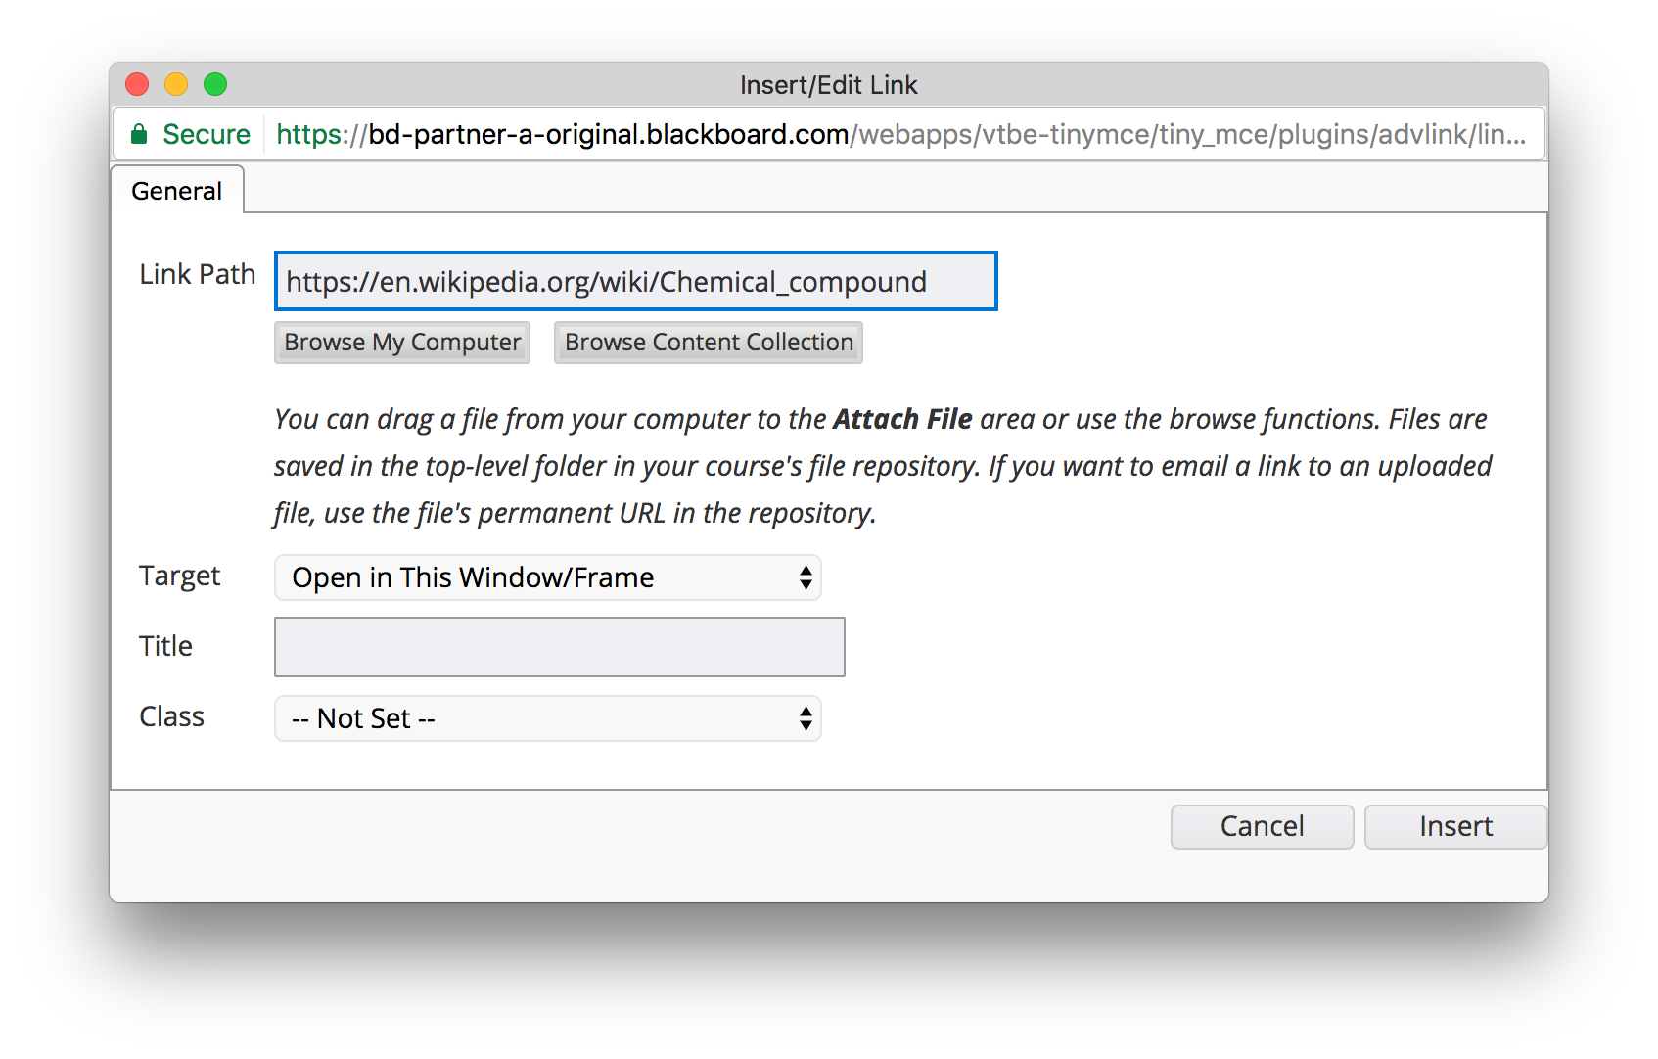
7. Links
Enter the URL of the link under “Link Path”
Click the “Insert” button

Slide 79
8. Scanned Documents
Scanned documents are essentially one image per page
Screen readers or other assistive technology are unable to convert images into text
Scanned documents, especially poor quality scans or handwriting, can be difficult to read for everyone
Other benefits of having digital copy
Can be searched
Can copy and paste text
Should be avoided as much as possible

Slide 80
9. Tagged PDFs
PDF tags are hidden labels that clarify the structure of the document and define what’s a heading, paragraph, table, list, etc.
PDF is originally a print format. Without tags, PDF documents are a bag of characters
Untagged PDFs can be really hard to navigate and understand for people with screen readers or other assistive devices
Can sometimes be difficult to do
Avoid printing as PDF as it loses all semantic information

Slide 81
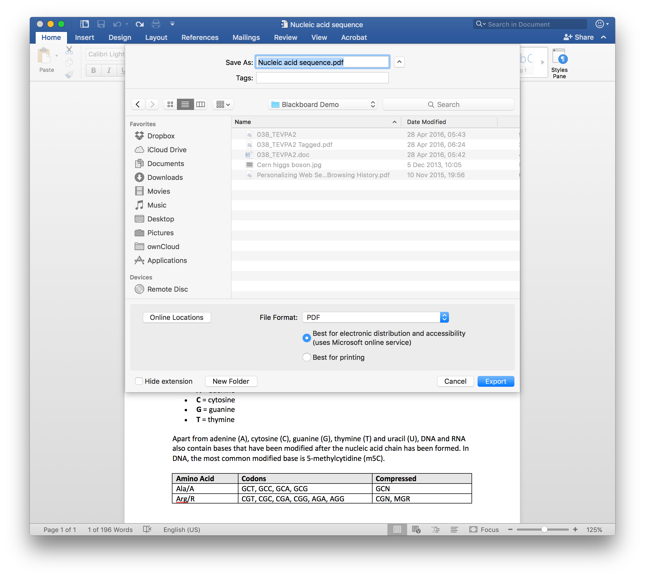
9. Tagged PDFs

Slide 82
Checklist
Use a large enough font
Ensure that there is sufficient contrast between text and background
Ensure that proper heading styles are used
Ensure that a logical heading structure is used
Ensure that built-in powerpoint slide templates are used
Ensure that images have an alternative description that can convey the full meaning of the image
Ensure that tables are used for tabular data
Ensure all table columns have a column heading
Ensure that all lists use built-in list functionality
Ensure that all links have text that describes the target
Ensure that no scanned PDFs are used
Ensure that all PDFs are tagged

Slide 83
Useful Tools

Slide 84
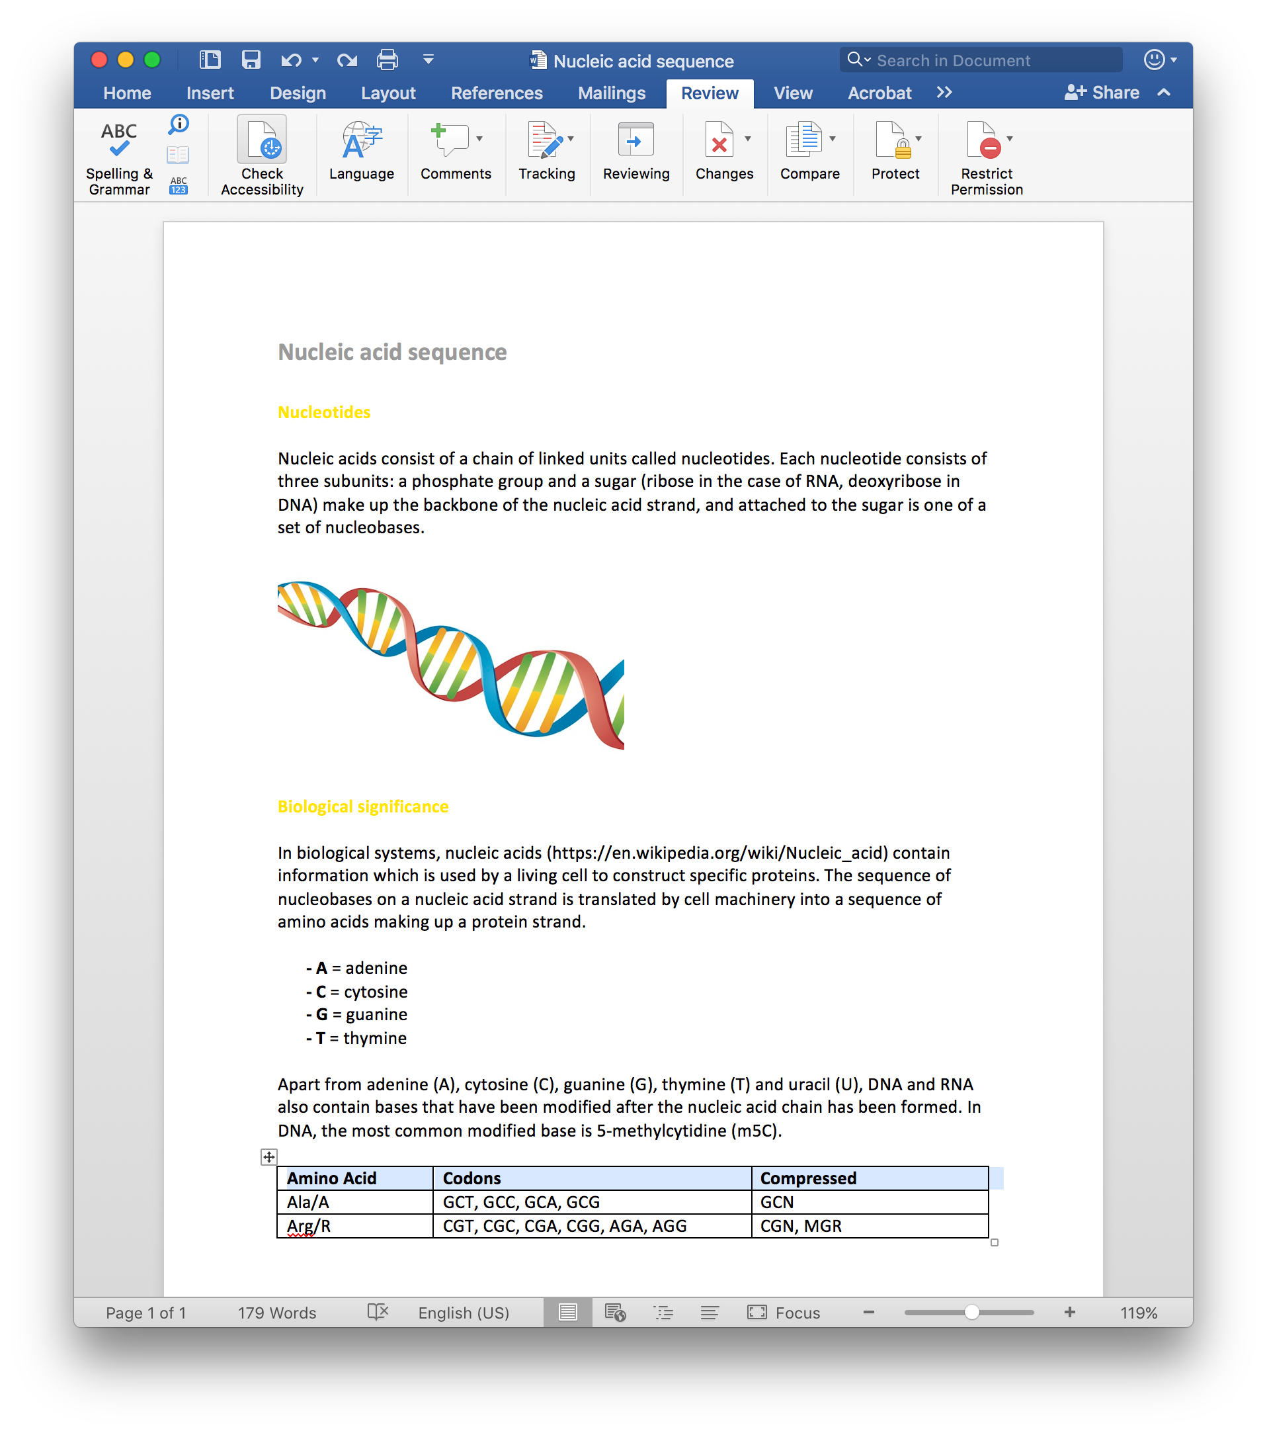
Microsoft Office Accessibility Checker
Word, Powerpoint
Limited in scope
Can help catch issues early on

Slide 85
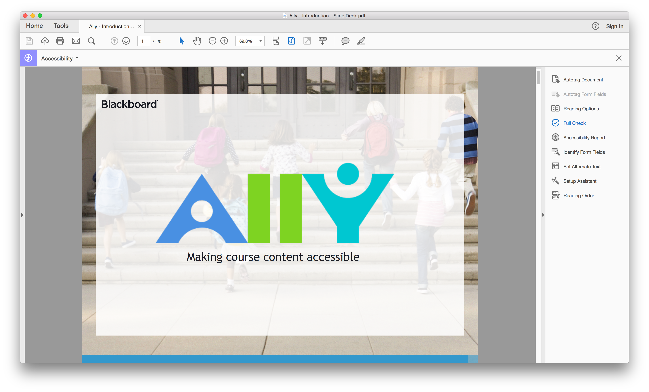
PDF Accessibility Checker
Requires Adobe Acrobat
Assess accessibility of PDFs

Slide 86
Color Contrast Analyser
https://www.paciellogroup.com/resources/contrastanalyser/
Point-and-click approach

Slide 87
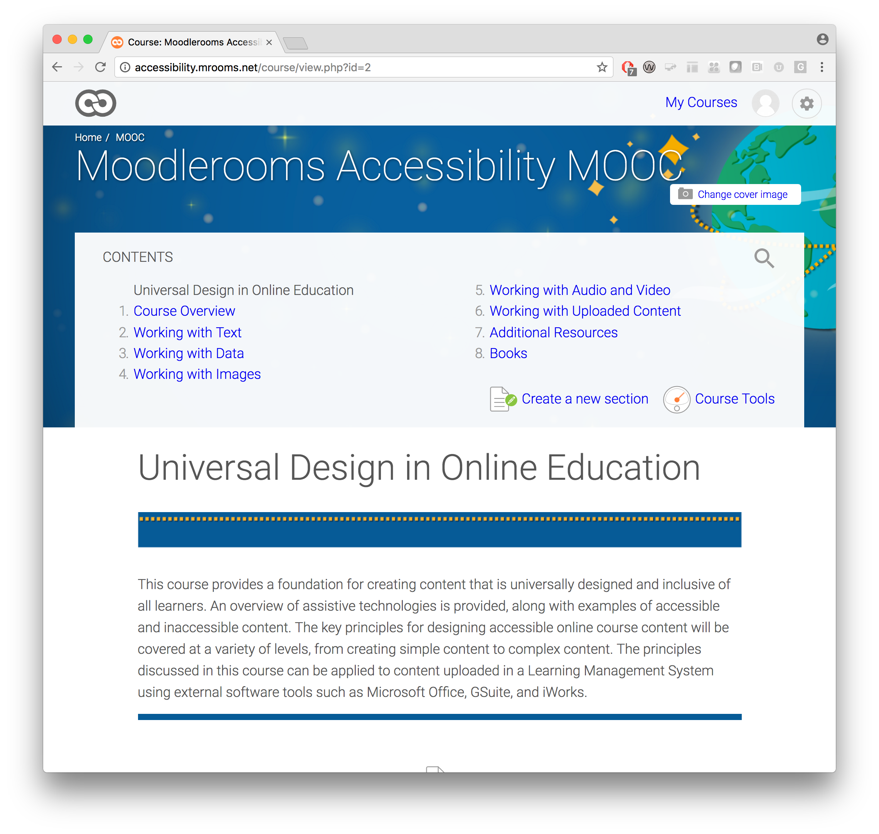
Blackboard Accessibility MOOC
Inclusive Online Course Design
Developed and run in collaboration with the University of Montana
http://go.blackboard.com/AXMOOC

Slide 88

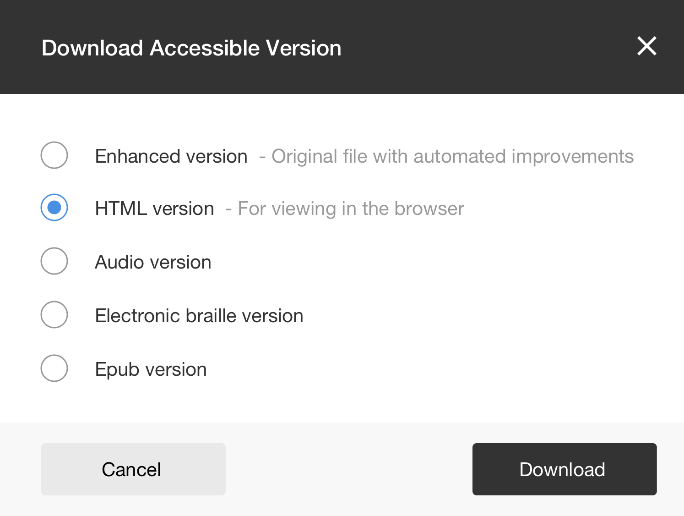
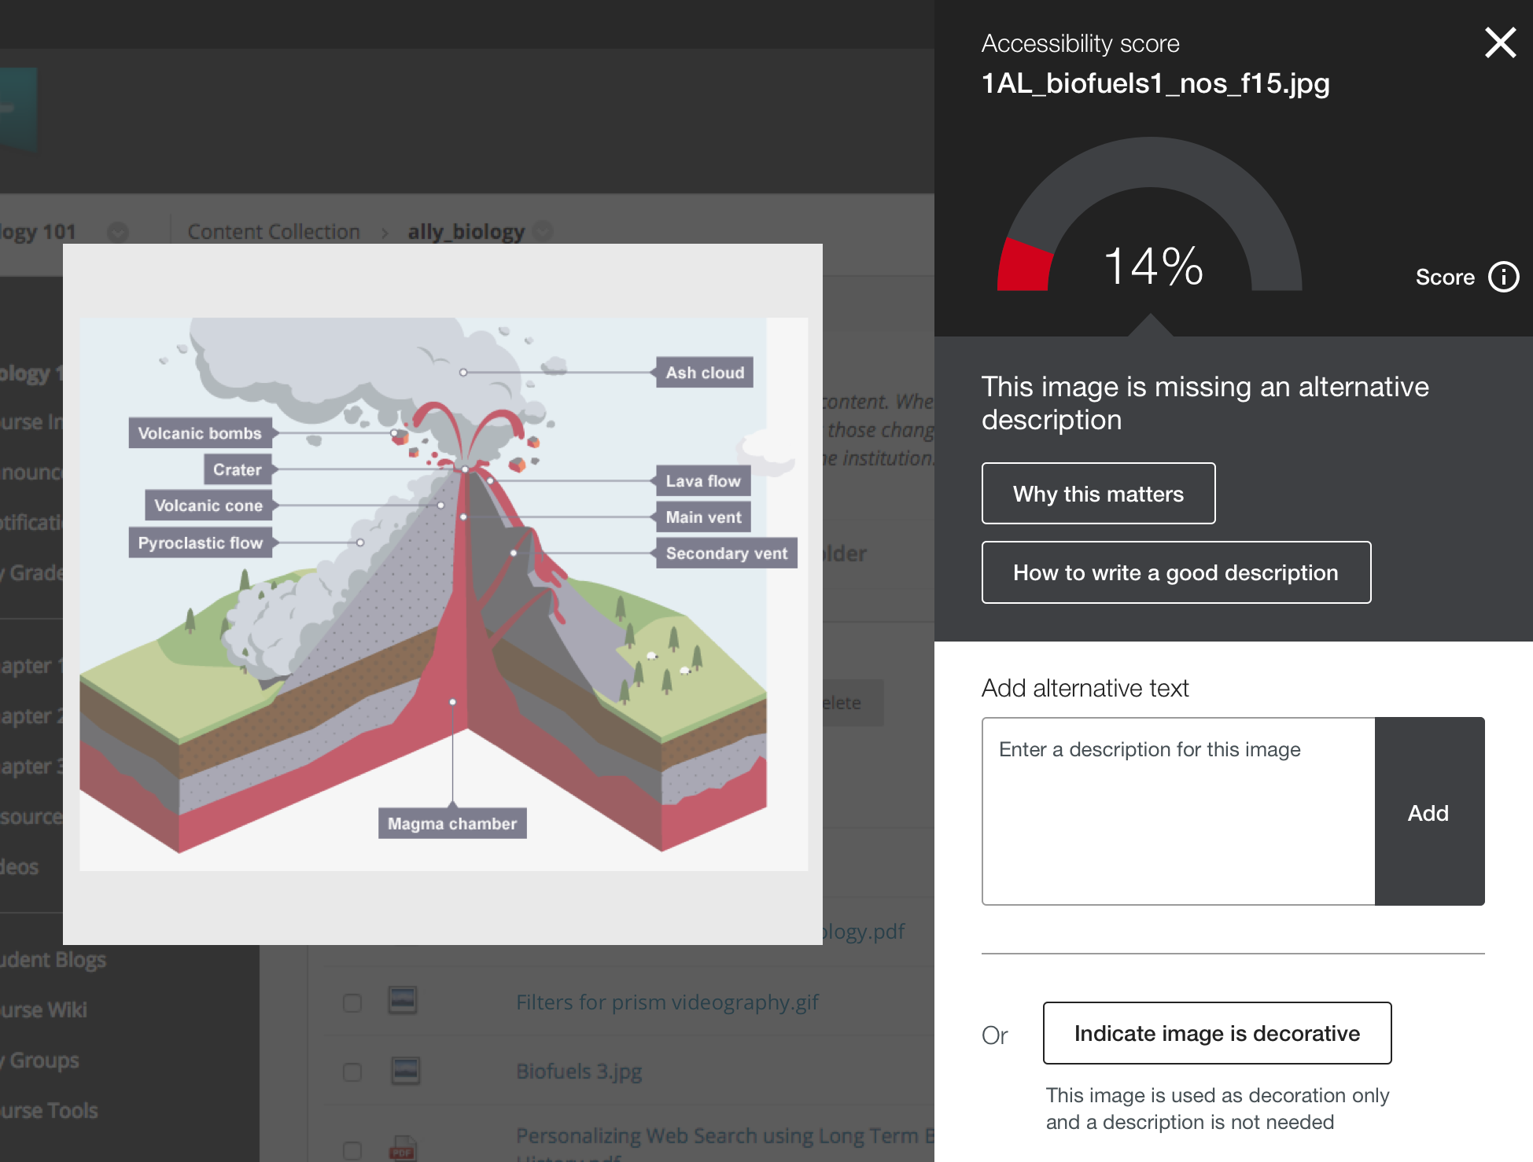
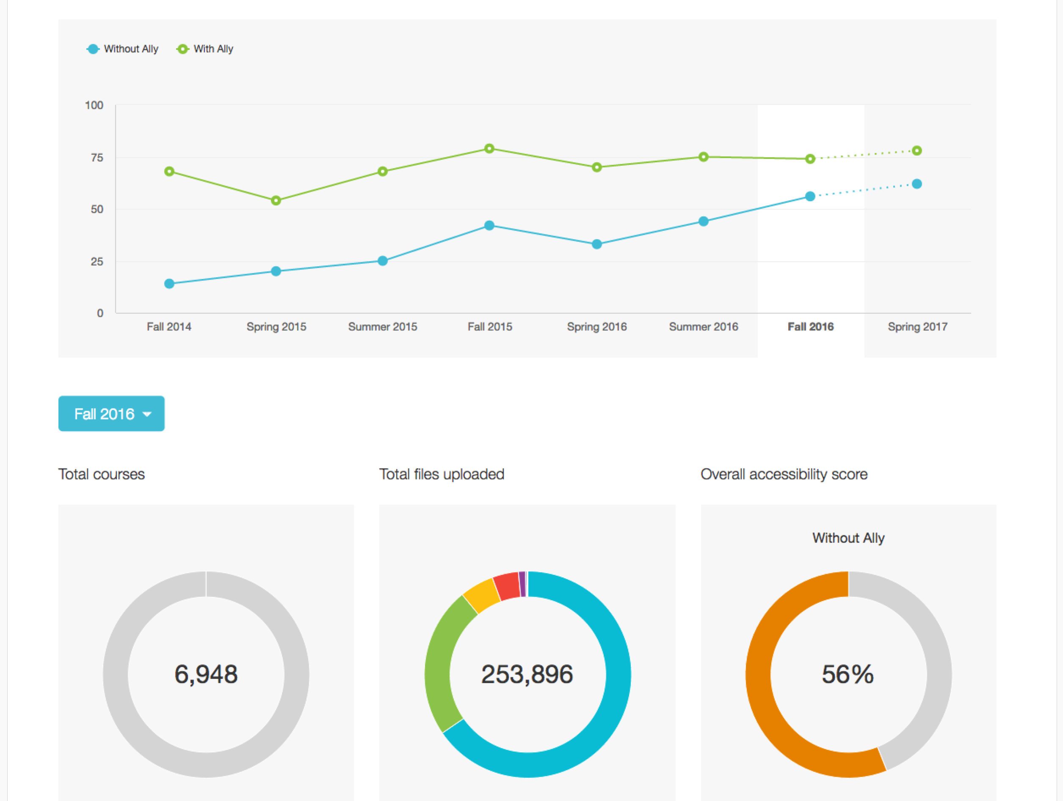
Blackboard Ally
Alternative Accessible Versions
Instructor feedback
Institutional report
Automatically checks for accessibility issues and generates alternative accessible formats
Guides instructors on how to improve the accessibility of their course content and alters future behavior
Provides detailed data and insights to help further improve course content accessibility at the institution

Slide 89
Summary

Slide 90
Summary
Accessibility is not only about providing access to students with disabilities. It is about providing better access to all students.
Accessibility is about creating higher quality and more usable experiences that can benefit all learners.
The current state of accessibility is quite poor. While some minor progress has been made, there is a lot of work left.
We need to focus on building awareness and breaking down walls.
Improving accessibility shouldn’t happen after the fact, it should be part of the creation workflow.
Visit our booth!

Slide 91
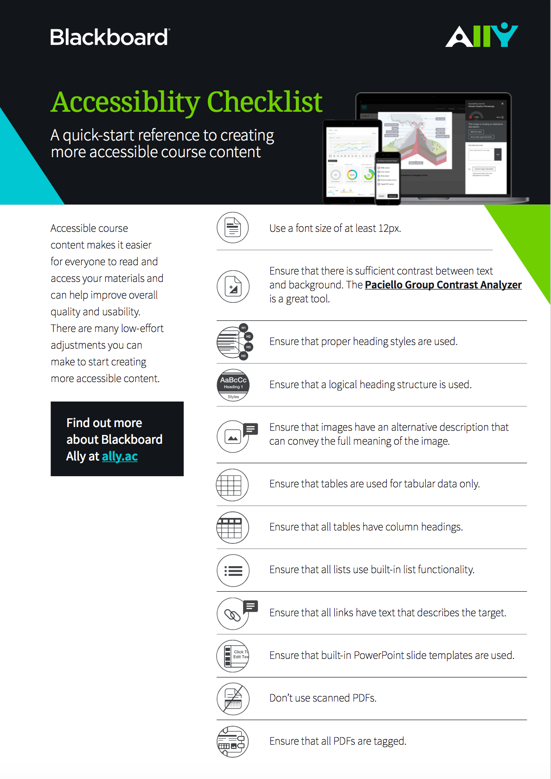
Accessibility Checklist
Accessibility Checklist is available as hand-out
Can be downloaded from http://tinyurl.com/bb-accessibility-checklist

Slide 92
The institution-wide impact of accessibility

